Slide 1
Cognitive science and NLP
Pathways to Human-like Language Models
Antonio Fonseca - Nov 10th, 2020

Slide 2
Common Sense before Language
‘[a] program has common sense if it automatically deduces for itself a sufficiently wide class of immediate consequences of anything it is told and what it already knows’. J. McCarthy, 1959
Example for Language Models:
‘The falling rock smashed the bottle because it was heavy’
‘The falling rock smashed the bottle because it was fragile’

Slide 3
Common Sense before Language
‘[a] program has common sense if it automatically deduces for itself a sufficiently wide class of immediate consequences of anything it is told and what it already knows’. J. McCarthy, 1959
Example for Language Models:
‘The falling rock smashed the bottle because it was heavy’
‘The falling rock smashed the bottle because it was fragile’

Slide 4

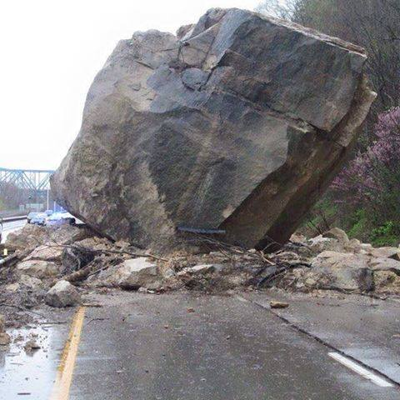
Understanding Language
‘The falling rock smashed the bottle’
We will need to know:
What a rock is (object properties)
What it means for something to fall (motion and space)
Falling and smashing (causality)
The understanding of objects, motion, space, and causality is a prerequisite for understanding any aspect of the everyday world

Slide 5
Learning (according to cog. science)
Humans & non-human animals can:
“An agent can perceive and interact with the environment”
3D spatial environment in which it can move and that contains objects that it can interact with.
“An agent is motivated by its homeostatic needs”
Basic needs induce behaviour rather than doing nothing

Slide 6
Elements of Cognition
Disembodied cognition
“There is a great difference between mind and body, inasmuch as body is by nature always divisible, and the mind is entirely indivisible... the mind or soul of man is entirely different from the body.” Rene Descartes’ theory of mind, 17th century
Embodied cognition
“... [the mind] arises from the nature of our brains, bodies, and bodily experiences. This is not just the innocuous and obvious claim that we need a body to reason; rather, it is the striking claim that the very structure of reason itself comes from the details of our embodiment... Thus, to understand reason we must understand the details of our visual system, our motor system, and the general mechanism of neural binding.” George Lakoff, 2011

Slide 7
Body and mind
Thinking about the future caused participants to lean slightly forward while thinking about the past caused participants to lean slightly backwards. Future is Ahead
Subjects were asked to remember a time when they were either socially accepted or socially snubbed. Those with warm memories of acceptance judged the room to be 5 degrees warmer on the average than those who remembered being coldly snubbed. Affection Is Warmth
Subjects asked to think about a moral transgression like adultery or cheating on a test were more likely to request an antiseptic cloth after the experiment than those who had thought about good deeds. Morality is Purity
McNerney, Samuel. "A brief guide to embodied cognition: Why you are not your brain." Scientific American 4 (2011).

Slide 8
Paper 1: To Test Machine Comprehension, Start by Defining Comprehension
Question-Answering task:
“The more difficult the QA task, more robust the comprehension”
QA satisfies the “how”, but not “what” to test.
Content: what information expressed, implied, or relied on by the passage
What about the current datasets?

Slide 9
Manually written questions
-TREC-8 (Voorhees and Tice, 2000)
- SNLI (Bowman et al., 2015)
- MNLI (Williams et al., 2018)
- NewsQA (Trischler et al., 2017)
- SQuAD (Rajpurkar et al., 2016)
- NarrativeQA (Kocisky et al. , 2018)
- DuoRC (Saha et al., 2018)
- MCTest (Richardson et al., 2013)
- MultiRC (Khashabi et al., 2018)
- ROPES (Lin et al., 2019)
- HotpotQA (Yang et al., 2018b)
- QASC (Khot et al., 2019)
- Quoref (Dasigi et al., 2019)
- Winograd (Levesque et al., 2012)
- DROP (Dua et al., 2019)
- Cosmos QA (Huang et al., 2019)
- SQuADRUn (Rajpurkar et al., 2018)
No guidance regarding what questions to ask

Slide 10
Manually written questions
-TREC-8 (Voorhees and Tice, 2000)
- SNLI (Bowman et al., 2015)
- MNLI (Williams et al., 2018)
- NewsQA (Trischler et al., 2017)
- SQuAD (Rajpurkar et al., 2016)
- NarrativeQA (Kocisky et al. , 2018)
- DuoRC (Saha et al., 2018)
- MCTest (Richardson et al., 2013)
- MultiRC (Khashabi et al., 2018)
- ROPES (Lin et al., 2019)
- HotpotQA (Yang et al., 2018b)
- QASC (Khot et al., 2019)
- Quoref (Dasigi et al., 2019)
- Winograd (Levesque et al., 2012)
- DROP (Dua et al., 2019)
- Cosmos QA (Huang et al., 2019)
- SQuADRUn (Rajpurkar et al., 2018)
Constraint: to produce one entailed, one contradicted, and one neutral hypothesis

Slide 11
Manually written questions
-TREC-8 (Voorhees and Tice, 2000)
- SNLI (Bowman et al., 2015)
- MNLI (Williams et al., 2018)
- NewsQA (Trischler et al., 2017)
- SQuAD (Rajpurkar et al., 2016)
- NarrativeQA (Kocisky et al. , 2018)
- DuoRC (Saha et al., 2018)
- MCTest (Richardson et al., 2013)
- MultiRC (Khashabi et al., 2018)
- ROPES (Lin et al., 2019)
- HotpotQA (Yang et al., 2018b)
- QASC (Khot et al., 2019)
- Quoref (Dasigi et al., 2019)
- Winograd (Levesque et al., 2012)
- DROP (Dua et al., 2019)
- Cosmos QA (Huang et al., 2019)
- SQuADRUn (Rajpurkar et al., 2018)
Constraint: questions had to be answerable with short phrases

Slide 12
Manually written questions
-TREC-8 (Voorhees and Tice, 2000)
- SNLI (Bowman et al., 2015)
- MNLI (Williams et al., 2018)
- NewsQA (Trischler et al., 2017)
- SQuAD (Rajpurkar et al., 2016)
- NarrativeQA (Kocisky et al. , 2018)
- DuoRC (Saha et al., 2018)
- MCTest (Richardson et al., 2013)
- MultiRC (Khashabi et al., 2018)
- ROPES (Lin et al., 2019)
- HotpotQA (Yang et al., 2018b)
- QASC (Khot et al., 2019)
- Quoref (Dasigi et al., 2019)
- Winograd (Levesque et al., 2012)
- DROP (Dua et al., 2019)
- Cosmos QA (Huang et al., 2019)
- SQuADRUn (Rajpurkar et al., 2018)
Example of a “good” and a “bad” question and encouraged to use original wording

Slide 13
Manually written questions
-TREC-8 (Voorhees and Tice, 2000)
- SNLI (Bowman et al., 2015)
- MNLI (Williams et al., 2018)
- NewsQA (Trischler et al., 2017)
- SQuAD (Rajpurkar et al., 2016)
- NarrativeQA (Kocisky et al. , 2018)
- DuoRC (Saha et al., 2018)
- MCTest (Richardson et al., 2013)
- MultiRC (Khashabi et al., 2018)
- ROPES (Lin et al., 2019)
- HotpotQA (Yang et al., 2018b)
- QASC (Khot et al., 2019)
- Quoref (Dasigi et al., 2019)
- Winograd (Levesque et al., 2012)
- DROP (Dua et al., 2019)
- Cosmos QA (Huang et al., 2019)
- SQuADRUn (Rajpurkar et al., 2018)
Open-ended questions: workers tend to write simple questions that can be answered using lexical cues.

Slide 14
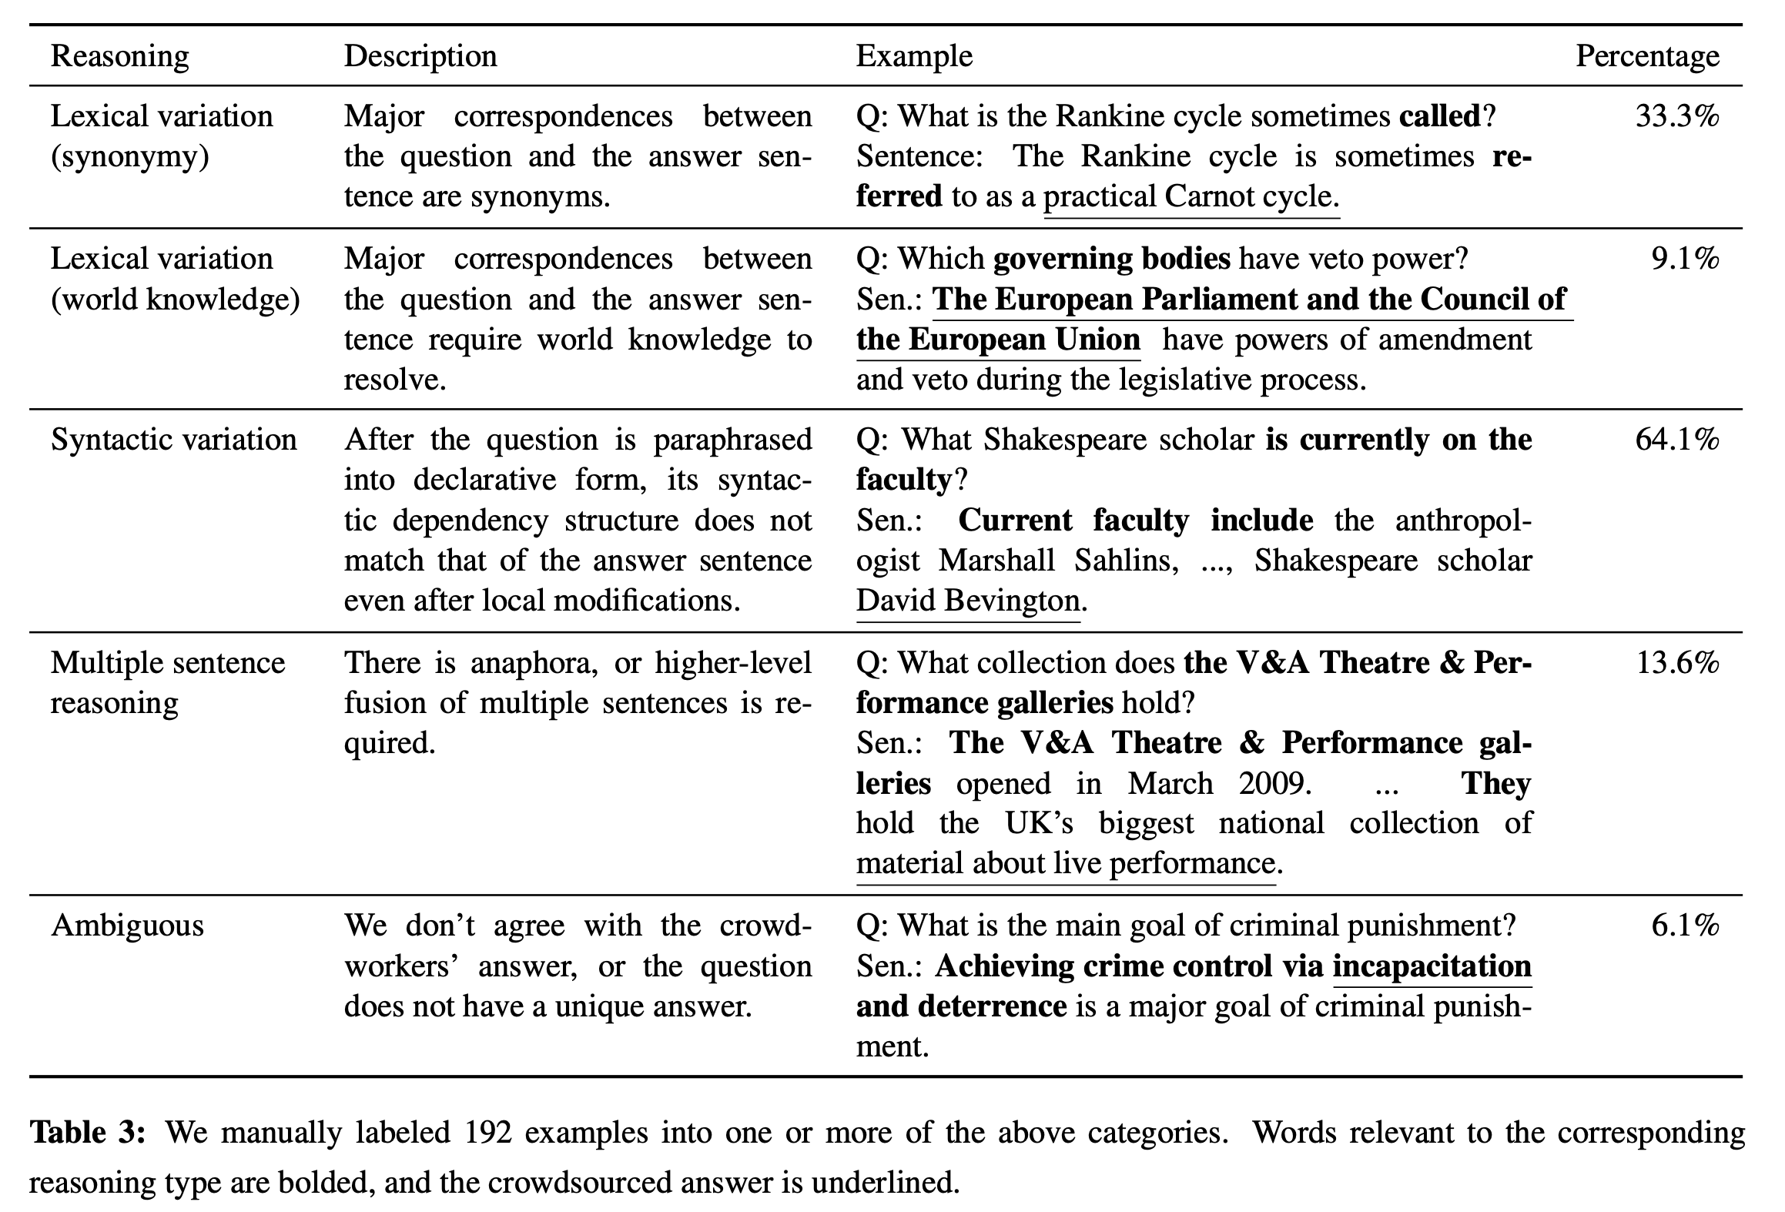
SQuAD (Rajpurkar et al., 2016)

Slide 15
Manually written questions
-TREC-8 (Voorhees and Tice, 2000)
- SNLI (Bowman et al., 2015)
- MNLI (Williams et al., 2018)
- NewsQA (Trischler et al., 2017)
- SQuAD (Rajpurkar et al., 2016)
- NarrativeQA (Kocisky et al. , 2018)
- DuoRC (Saha et al., 2018)
- MCTest (Richardson et al., 2013)
- MultiRC (Khashabi et al., 2018)
- ROPES (Lin et al., 2019)
- HotpotQA (Yang et al., 2018b)
- QASC (Khot et al., 2019)
- Quoref (Dasigi et al., 2019)
- Winograd (Levesque et al., 2012)
- DROP (Dua et al., 2019)
- Cosmos QA (Huang et al., 2019)
- SQuADRUn (Rajpurkar et al., 2018)
Open-ended questions: workers tend to write simple questions that can be answered using lexical cues.
Questionable measure of comprehension

Slide 16
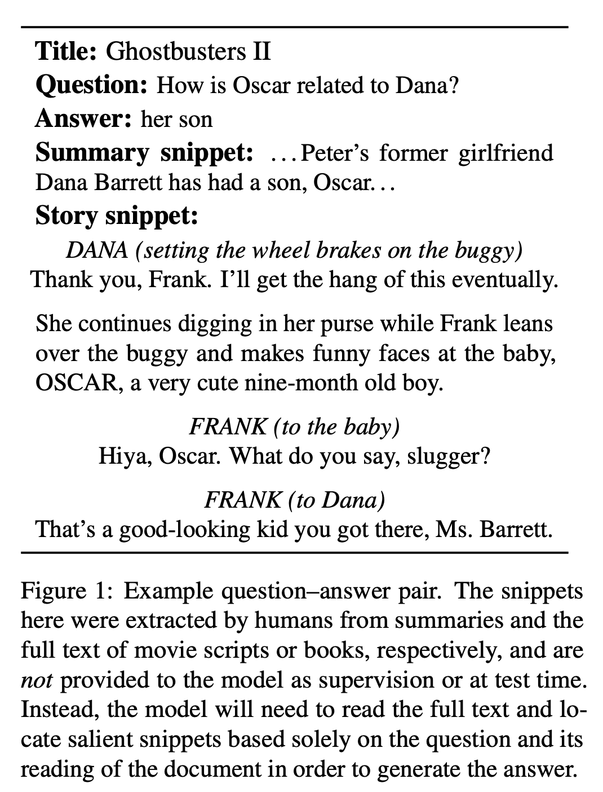
Manually written questions
-TREC-8 (Voorhees and Tice, 2000)
- SNLI (Bowman et al., 2015)
- MNLI (Williams et al., 2018)
- NewsQA (Trischler et al., 2017)
- SQuAD (Rajpurkar et al., 2016)
- NarrativeQA (Kocisky et al. , 2018)
- DuoRC (Saha et al., 2018)
- MCTest (Richardson et al., 2013)
- MultiRC (Khashabi et al., 2018)
- ROPES (Lin et al., 2019)
- HotpotQA (Yang et al., 2018b)
- QASC (Khot et al., 2019)
- Quoref (Dasigi et al., 2019)
- Winograd (Levesque et al., 2012)
- DROP (Dua et al., 2019)
- Cosmos QA (Huang et al., 2019)
- SQuADRUn (Rajpurkar et al., 2018)
reduce lexical similarity between questions and passages by showing only summaries

Slide 17
Manually written questions
-TREC-8 (Voorhees and Tice, 2000)
- SNLI (Bowman et al., 2015)
- MNLI (Williams et al., 2018)
- NewsQA (Trischler et al., 2017)
- SQuAD (Rajpurkar et al., 2016)
- NarrativeQA (Kocisky et al. , 2018)
- DuoRC (Saha et al., 2018)
- MCTest (Richardson et al., 2013)
- MultiRC (Khashabi et al., 2018)
- ROPES (Lin et al., 2019)
- HotpotQA (Yang et al., 2018b)
- QASC (Khot et al., 2019)
- Quoref (Dasigi et al., 2019)
- Winograd (Levesque et al., 2012)
- DROP (Dua et al., 2019)
- Cosmos QA (Huang et al., 2019)
- SQuADRUn (Rajpurkar et al., 2018)
questions that rely on multiple sentences

Slide 18
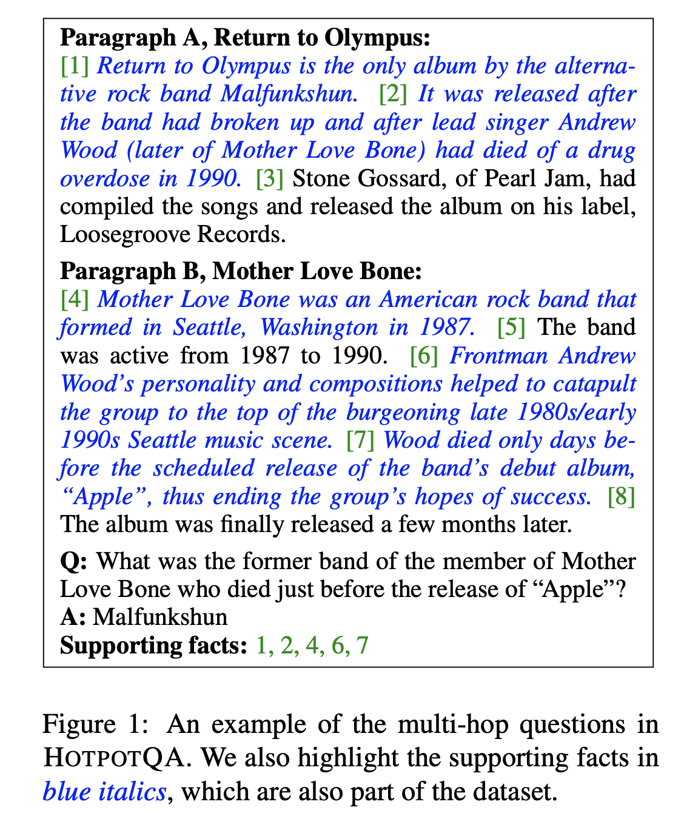
Manually written questions
-TREC-8 (Voorhees and Tice, 2000)
- SNLI (Bowman et al., 2015)
- MNLI (Williams et al., 2018)
- NewsQA (Trischler et al., 2017)
- SQuAD (Rajpurkar et al., 2016)
- NarrativeQA (Kocisky et al. , 2018)
- DuoRC (Saha et al., 2018)
- MCTest (Richardson et al., 2013)
- MultiRC (Khashabi et al., 2018)
- ROPES (Lin et al., 2019)
- HotpotQA (Yang et al., 2018b)
- QASC (Khot et al., 2019)
- Quoref (Dasigi et al., 2019)
- Winograd (Levesque et al., 2012)
- DROP (Dua et al., 2019)
- Cosmos QA (Huang et al., 2019)
- SQuADRUn (Rajpurkar et al., 2018)
Multi-hop reasoning

Slide 19
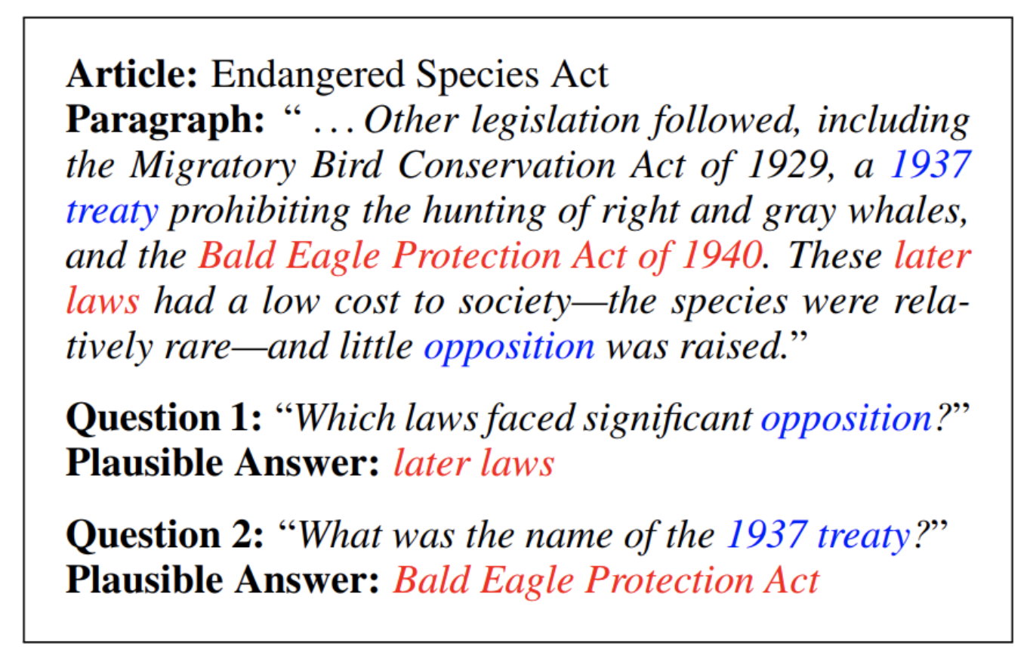
Manually written questions
-TREC-8 (Voorhees and Tice, 2000)
- SNLI (Bowman et al., 2015)
- MNLI (Williams et al., 2018)
- NewsQA (Trischler et al., 2017)
- SQuAD (Rajpurkar et al., 2016)
- NarrativeQA (Kocisky et al. , 2018)
- DuoRC (Saha et al., 2018)
- MCTest (Richardson et al., 2013)
- MultiRC (Khashabi et al., 2018)
- ROPES (Lin et al., 2019)
- HotpotQA (Yang et al., 2018b)
- QASC (Khot et al., 2019)
- Quoref (Dasigi et al., 2019)
- Winograd (Levesque et al., 2012)
- DROP (Dua et al., 2019)
- Cosmos QA (Huang et al., 2019)
- SQuADRUn (Rajpurkar et al., 2018)
SQuADRUn (Rajpurkar et al., 2018)
Unanswerable questions

Slide 20
Is difficult = useful?
Questions interesting for humans might not be a good test for comprehension
Easy QA tasks do not indicate usefulness
Harder QA helps… but doesn’t solve it all
What really matters:
Answering useful questions for a given application

Slide 21
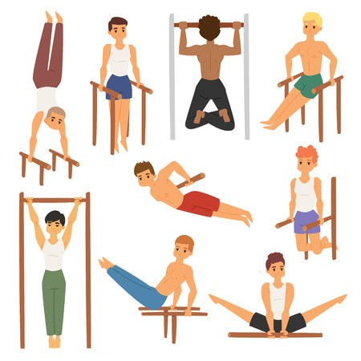

Testing the wrong thing
Future professional sprinter

Slide 22
Asking the right questions
Template of understanding (ToU)
Set of question templates that can be filled in with specific events and entities for any given passage
The answers will constitute a floor of understanding for the passage
How to do that and for what content?

Slide 23
ToU for stories
Evaluating the understanding of a story with four questions:
Spatial: Where is everything located and how is it positioned throughout the story?
Temporal: What events occur and when?
Causal: How do events lead mechanistically to other events?
Motivational: Why do the characters decide to take the actions they take?
Humans do the same in reading comprehension task (Zwaan et al., 1995)

Slide 24
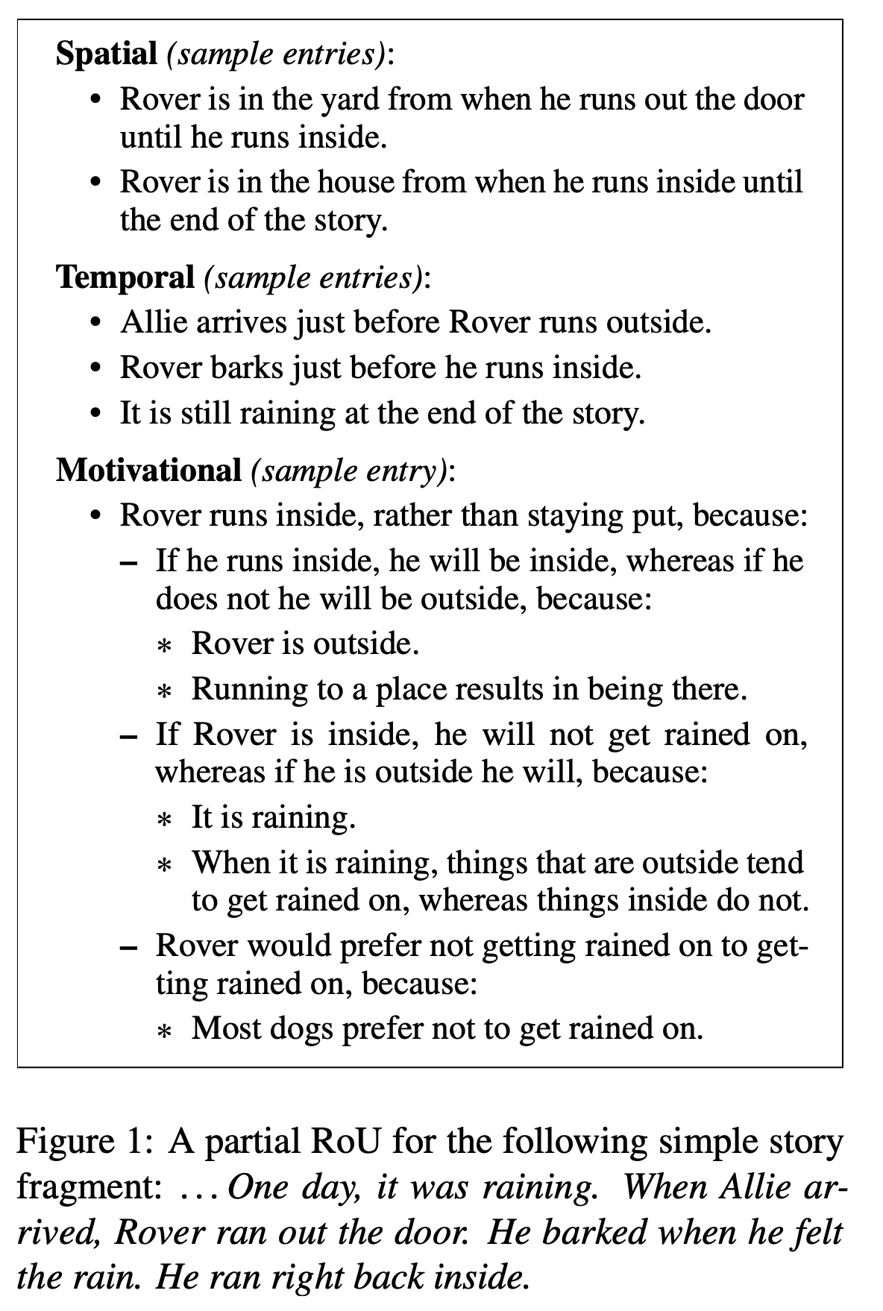
Annotating ToU answers
Why did Rover come inside, rather than remaining where he was?

Slide 25
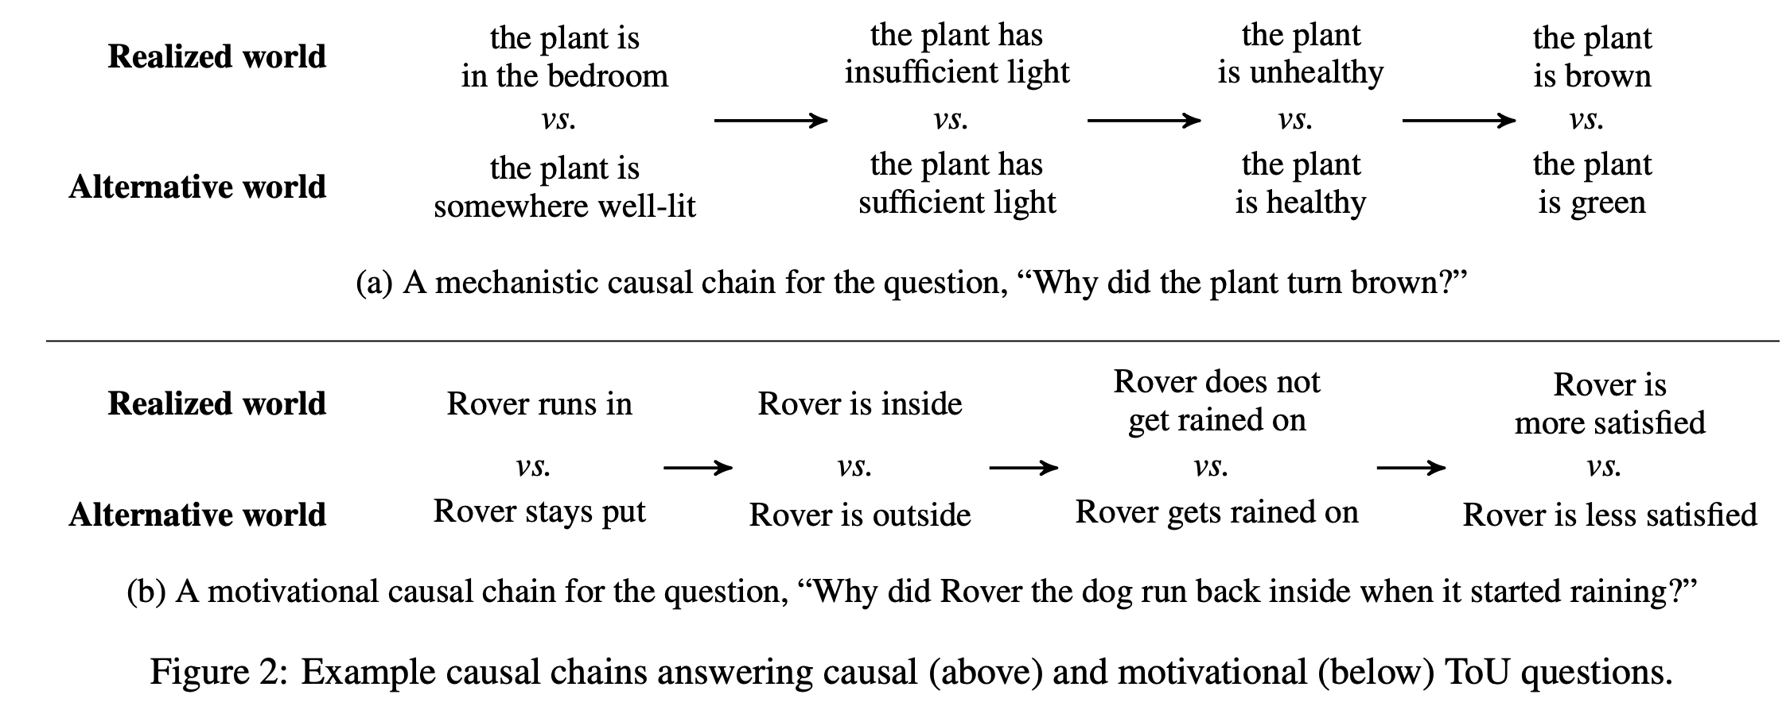

Slide 26
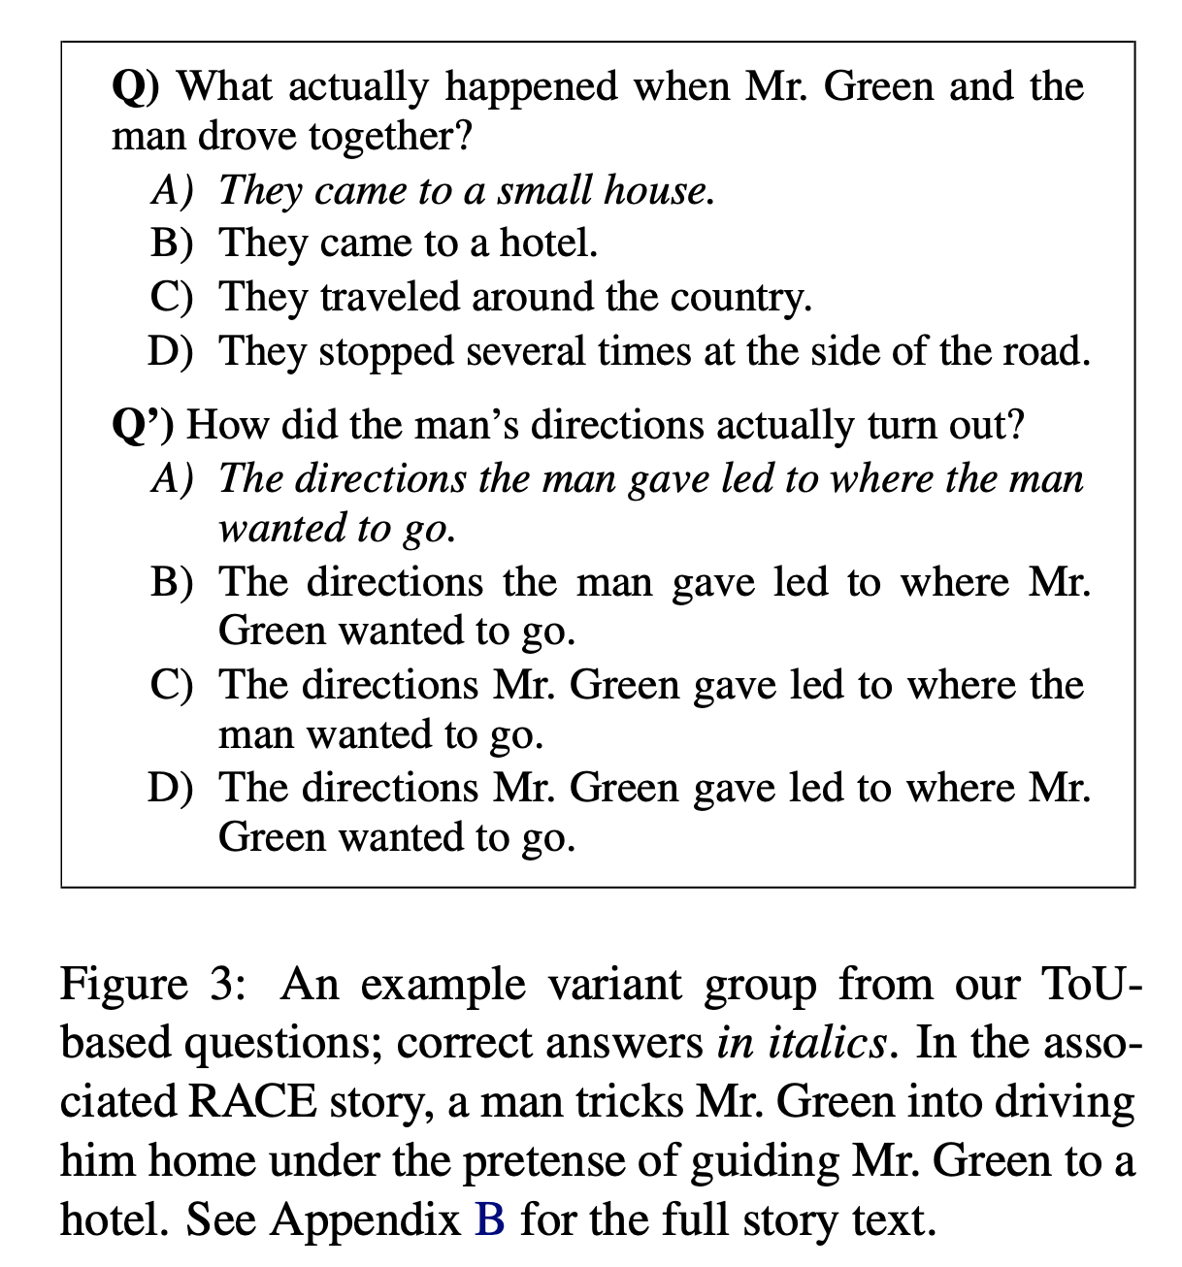
Experiment
Two narrative stories in the dev set of RACE (Lai et al., 2017)
Questions given in “variant groups”
Accuracy:
counting each question independently
counting each variant group as one unit.

Slide 27
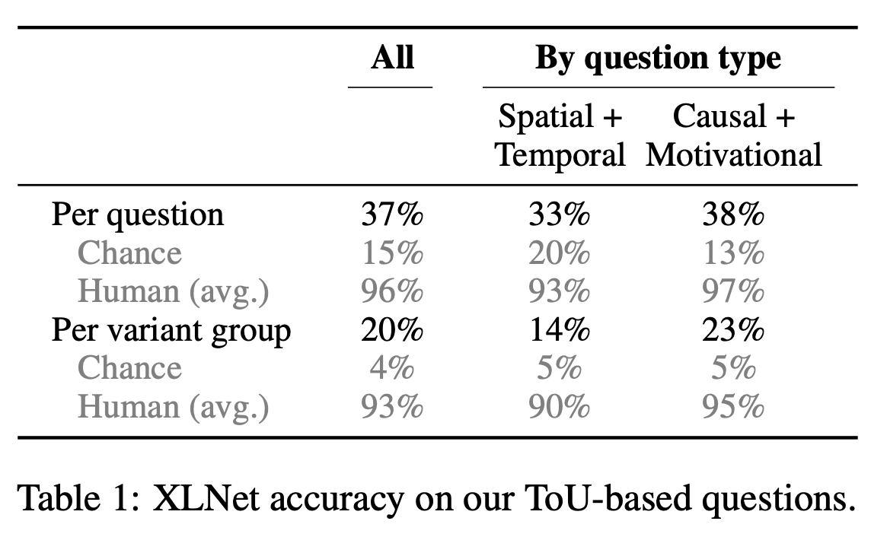
Results and conclusions
- XLNet is not learning the ToU’s crucial elements of world understanding (similar for other LMs).
- Evaluating open-end question is hard
- Mult. choice question is an option, but suboptimal
- The problem is far from solved…

Slide 28

Why the current LM fail?
The super-parots (BERT, GPTs, and XLNet)
“Based on all the documents I’ve seen, what would a human likely say next?”
The problem:
Training on documents written by humans for humans
Machines do not share our world knowledge
String probability guessers
Great for Machine Translation… but we can aim higher!

Slide 29
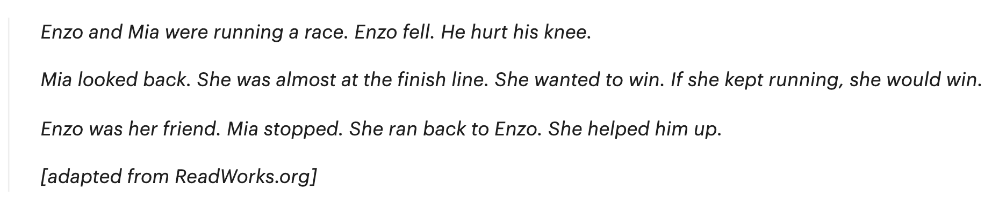
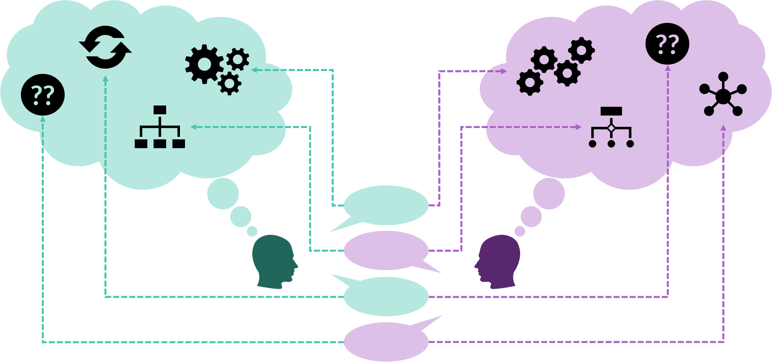
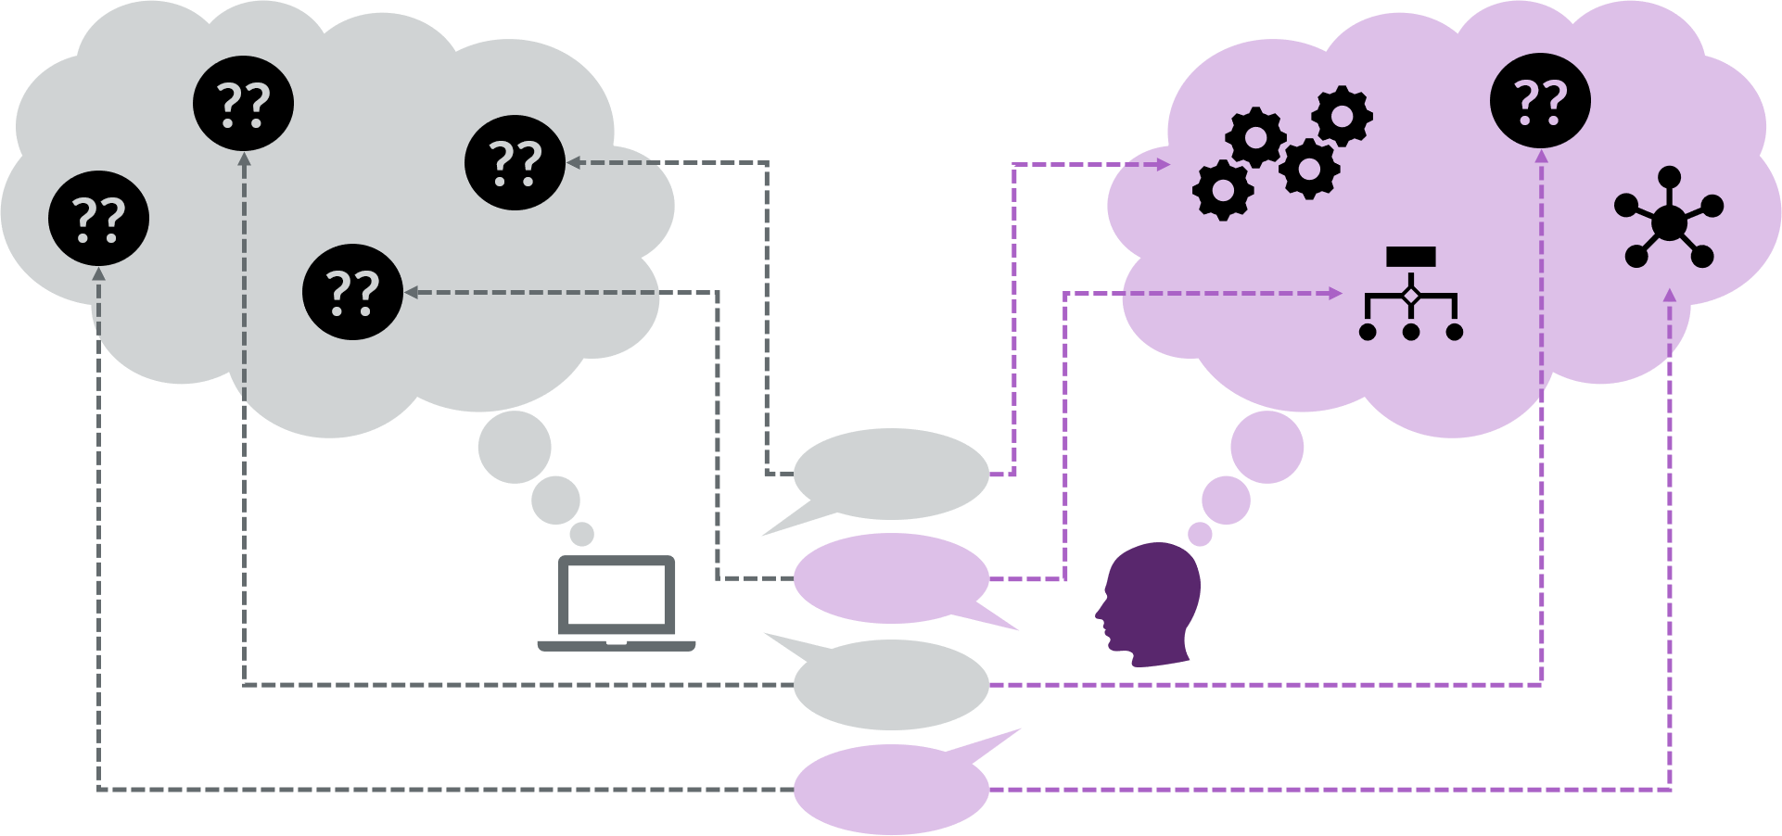
Mental model
How can we achieve a shared mental model with a machine?
Kindergarten story:

Slide 30
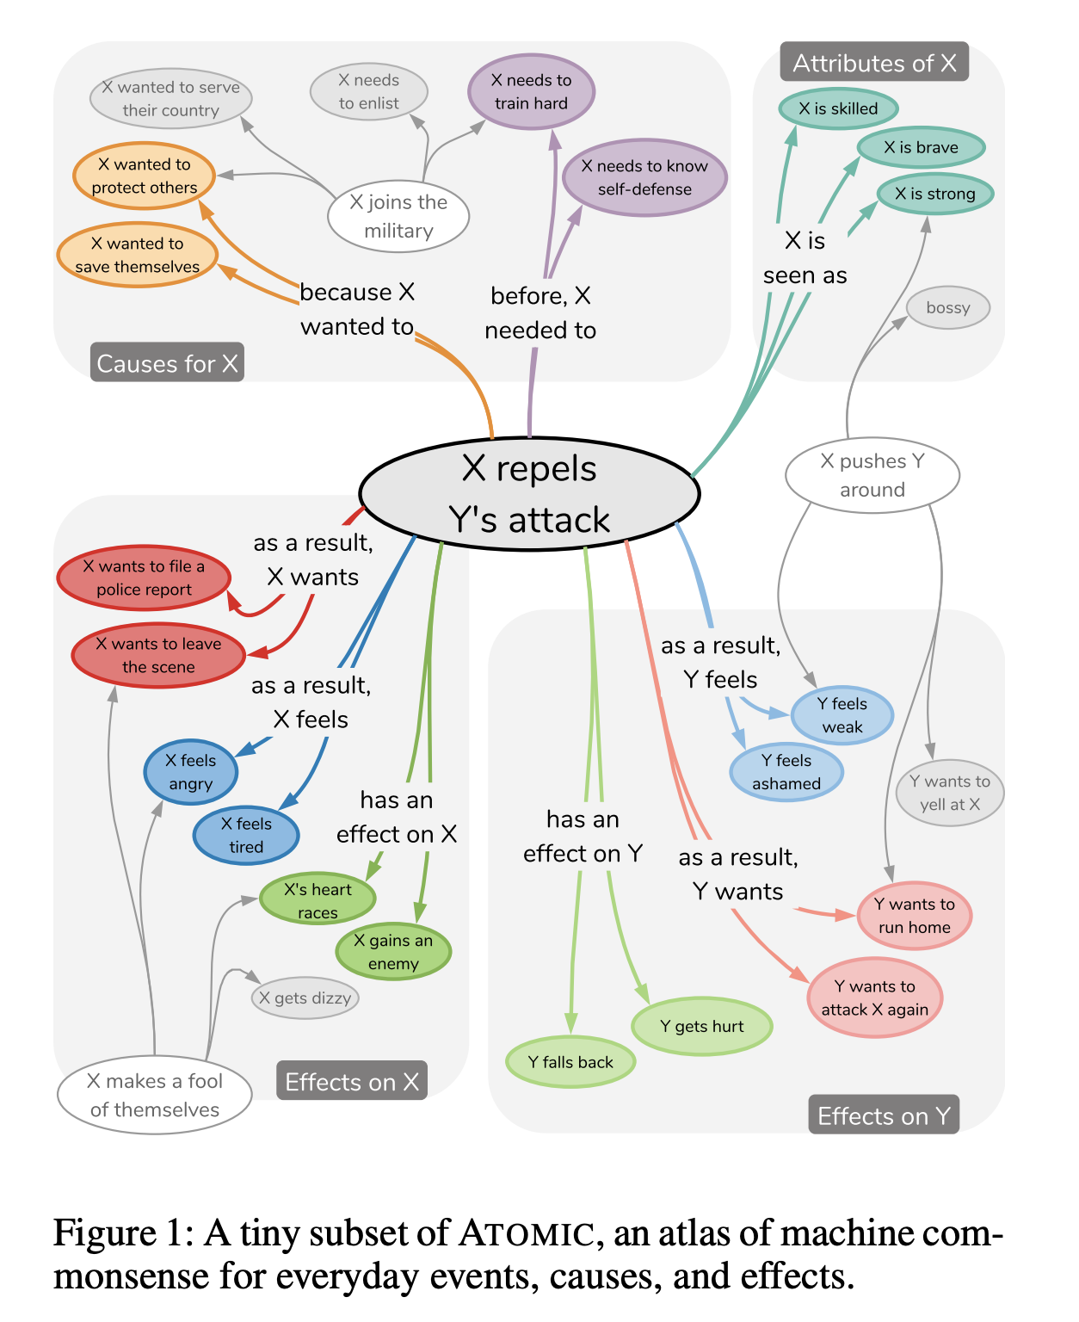
Paper 2: ATOMIC - An Atlas of Machine Commonsense for If-Then Reasoning
Inferential knowledge is crucial for automated commonsense reasoning
Trivial to humans, but not to AI

Slide 31
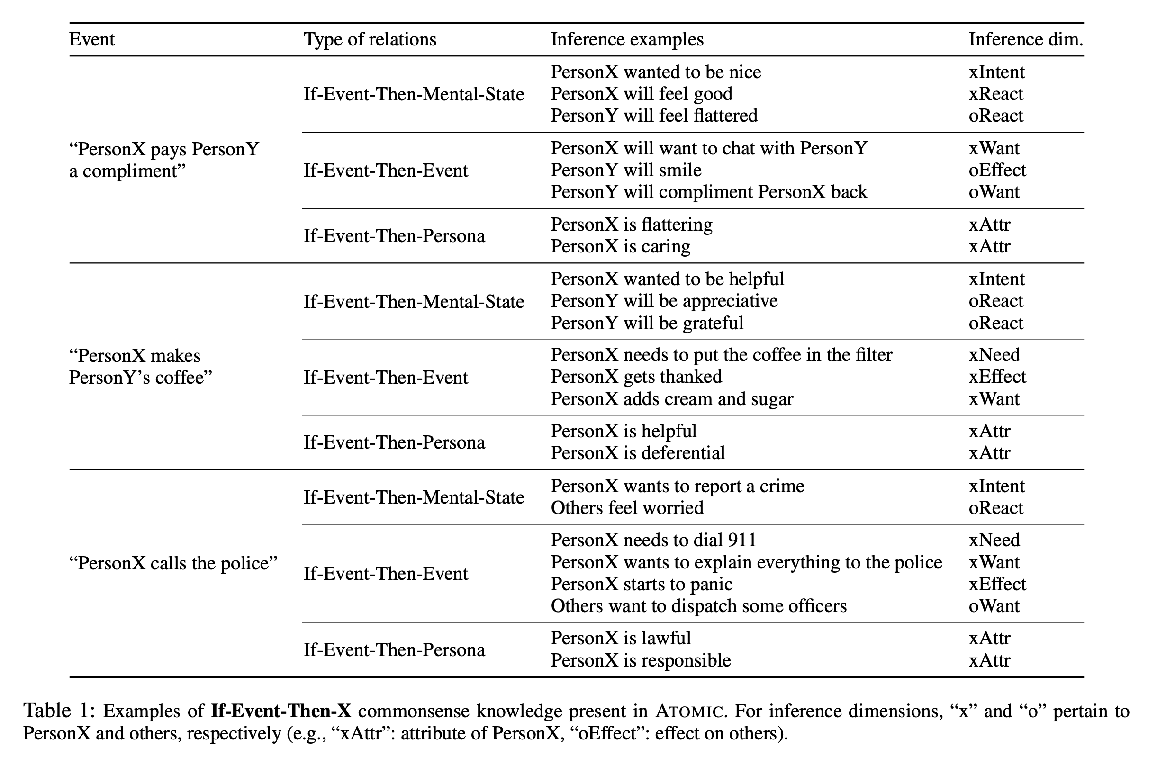

Slide 32
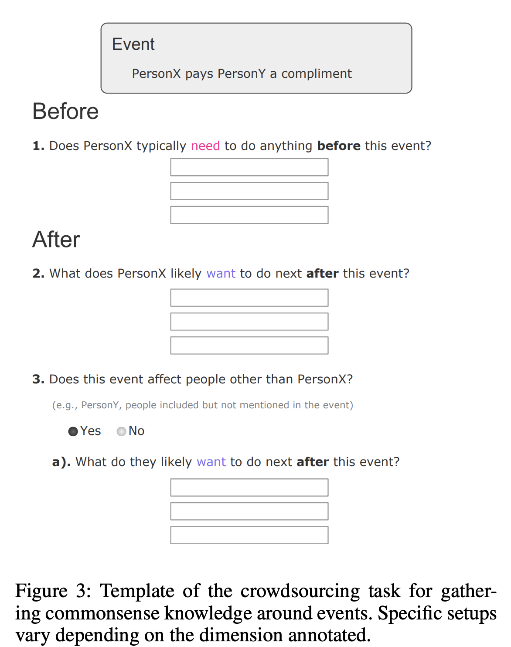
Compiling Base Events
PersonX drinks coffee
Crowdsourcing framework.
24K common event phrases from a variety of corpora (stories, books, Google Ngrams, and Wiktionary idiom).
877K textual descriptions of if-then knowledge
Event definition: verb phrases with a verb predicate and its arguments
Names replaced by token: “PersonX buys PersonY coffee”.
PersonX needed to brew coffee
PersonX needed to buy coffee
PersonX will attend to a zoom call

Slide 33
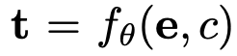
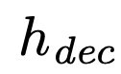
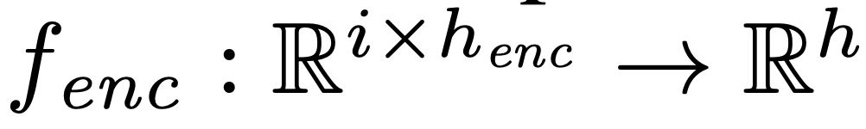
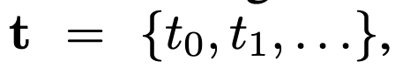
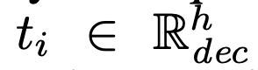
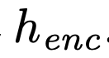
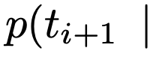
Model
Can a model learn to perform If-Then commonsense inference given a previously unseen event?
Encoder
Decoder
Unidirectional GRU to
300D GloVe pretrained embeddings
Augment these embeddings with 1024-dimensional ELMo pre-trained embeddings
Bidirectional GRU to

Slide 34
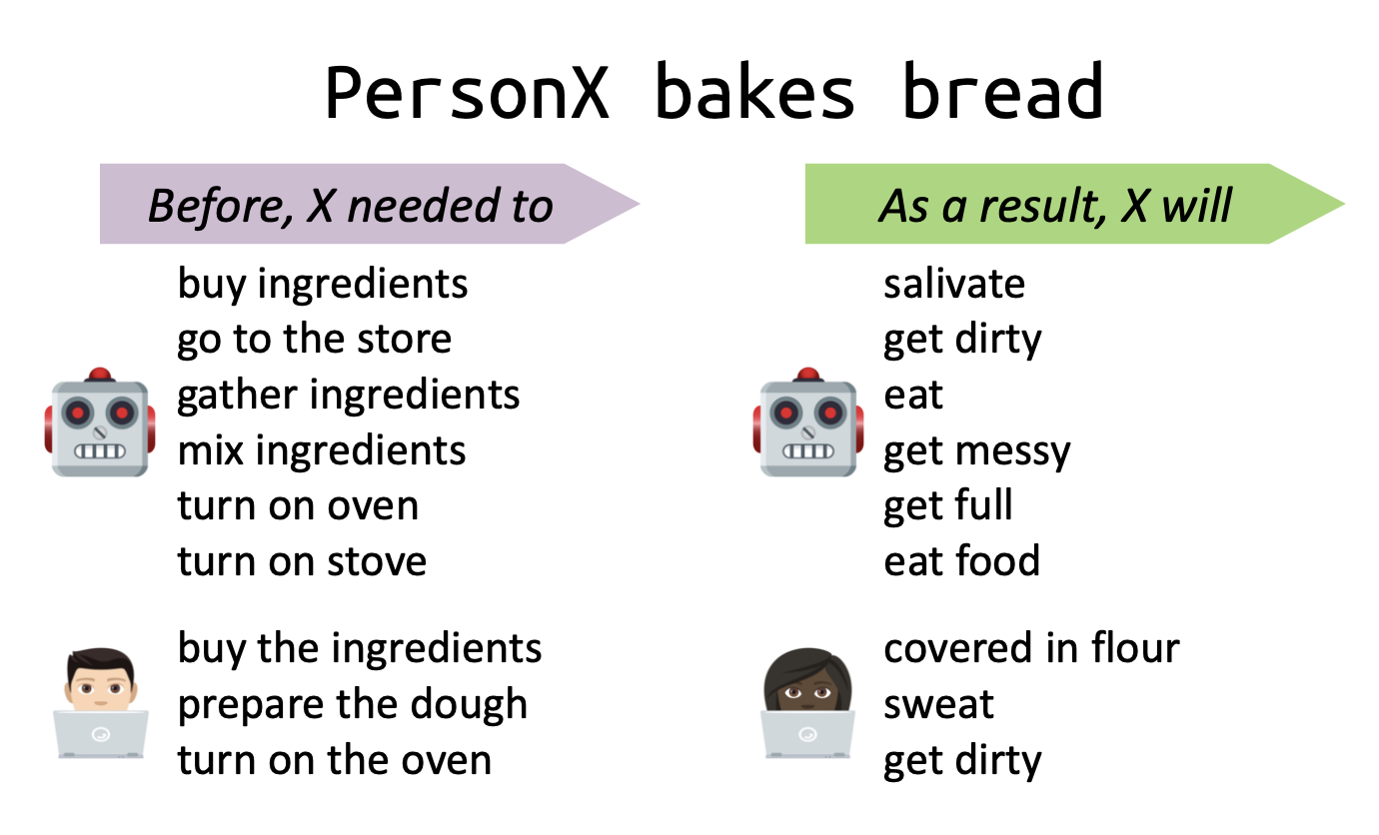
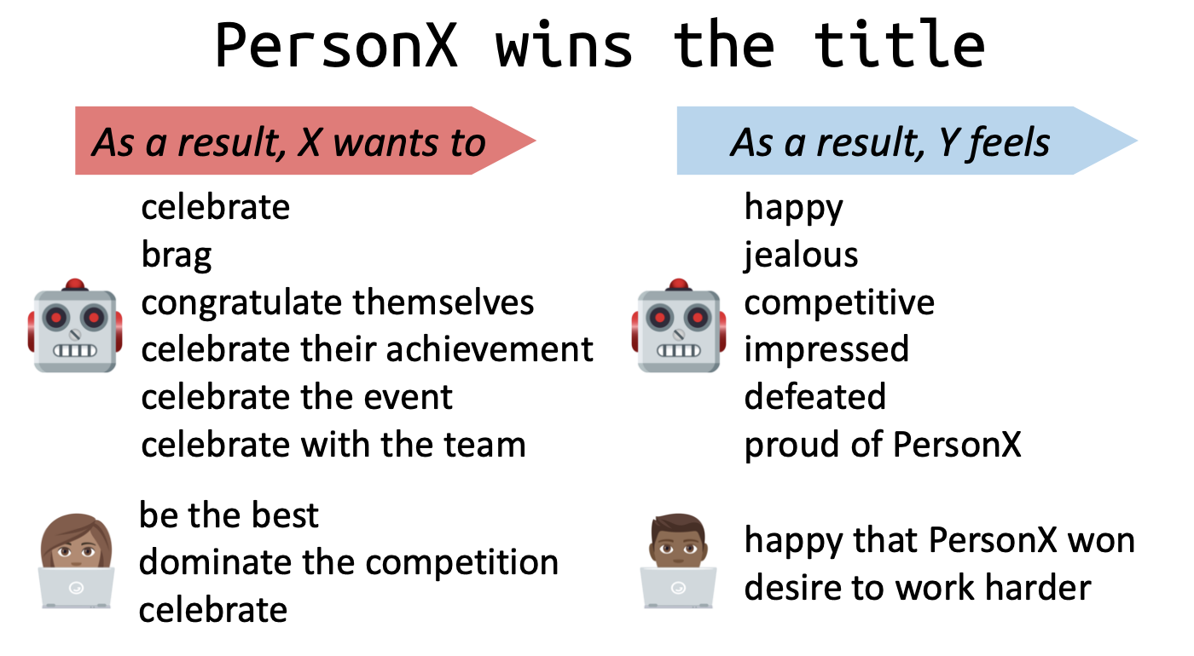
Results
Ability to reason about previously unseen events

Slide 35
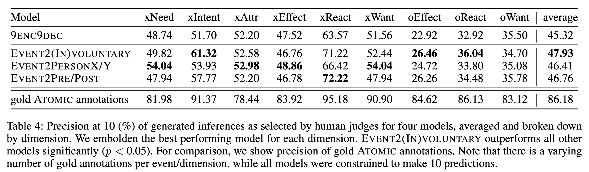
Results
EVENT2(IN)VOLUNTARY: voluntary (e.g., xIntent, oWant) or involuntary (e.g., xReact, oEffect)
EVENT2PERSONX/Y: event’s agent (PersonX) or event’s theme (others, or PersonY)
EVENT2PRE/POST: causes (xNeed, xIntent) or effects (e.g., xWant, oEffect, xReact).

Slide 36
But...
“PersonX arrives the next day”
xIntents: “to go on vacation”
xIntents: “to attend a reunion”
xEffects: “get time to relax”
xEffects: “meet some friends.”
✅
Problems:
Association between intent and effect is context independent
It’s person centric
✅
✅
✅

Slide 37
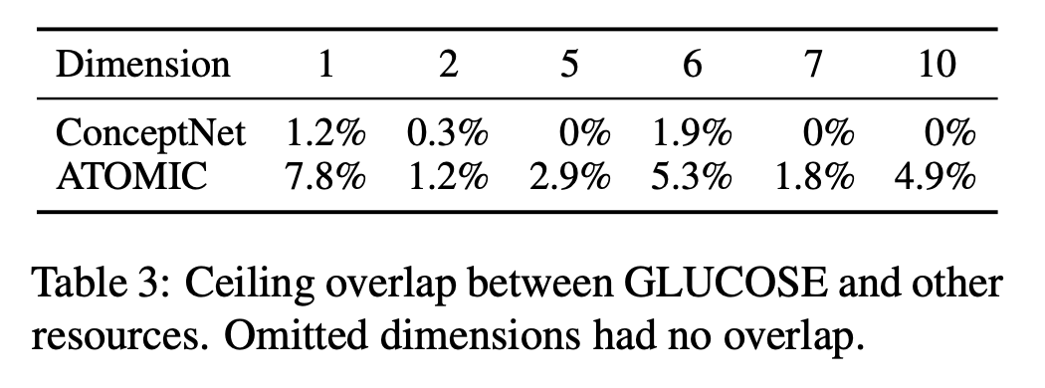
Paper 3: GLUCOSE: GeneraLized and COntextualized Story Explanation
Large-scale dataset of implicit commonsense causal knowledge
Encoded as causal mini theories about the world, each grounded in a narrative context

Slide 38
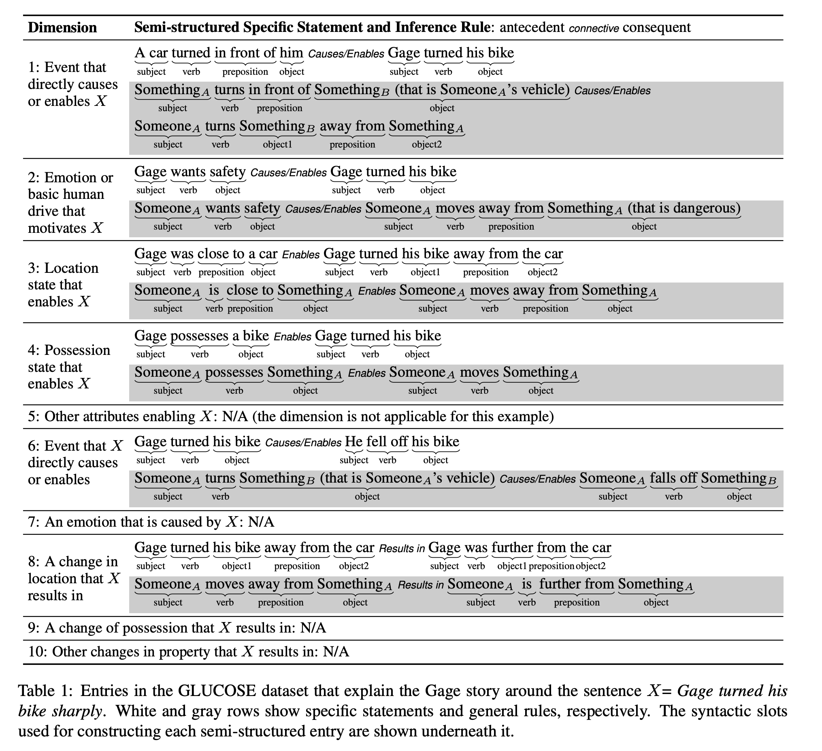
Model
Dimensions of causality: events and states happening before X and those occurring after X.
Each category includes five dimensions
Explanations are stated both as a specific statement (grounded in a given context) and a corresponding general rule (applicable to other contexts)
Ex: Gage was riding his bike. A car turned in front of him. Gage turned his bike sharply. He fell off of his bike. Gage skinned his knee

Slide 39
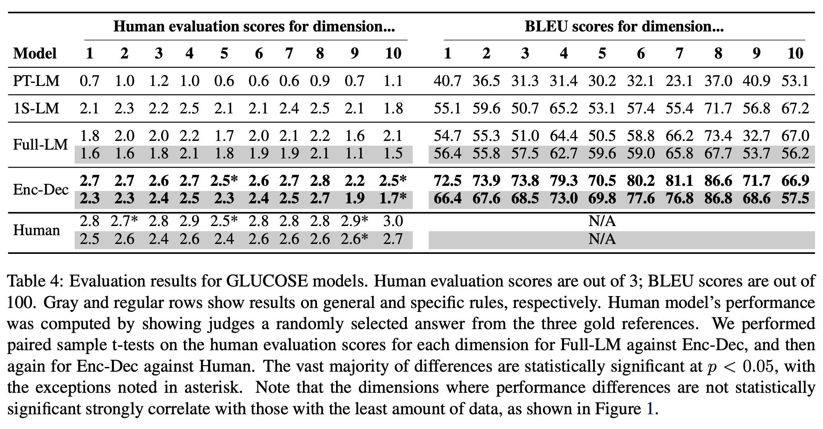
Results
774M-parameter GPT-2
770M-parameter T5

Slide 40
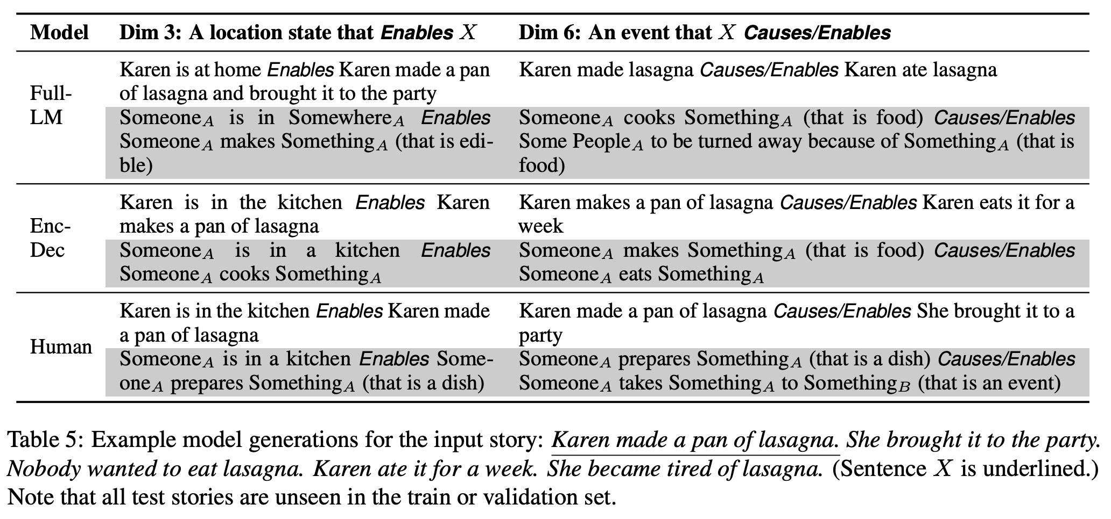
Results

Slide 41
Conclusions
Commonsense knowledge encoded as explanatory mini-theories in 10 dimensions (inspired by cognitive psychology).
~670K annotations in the context of everyday children’s stories.
Knowledge not available in existing resources or pre-trained models

Slide 42
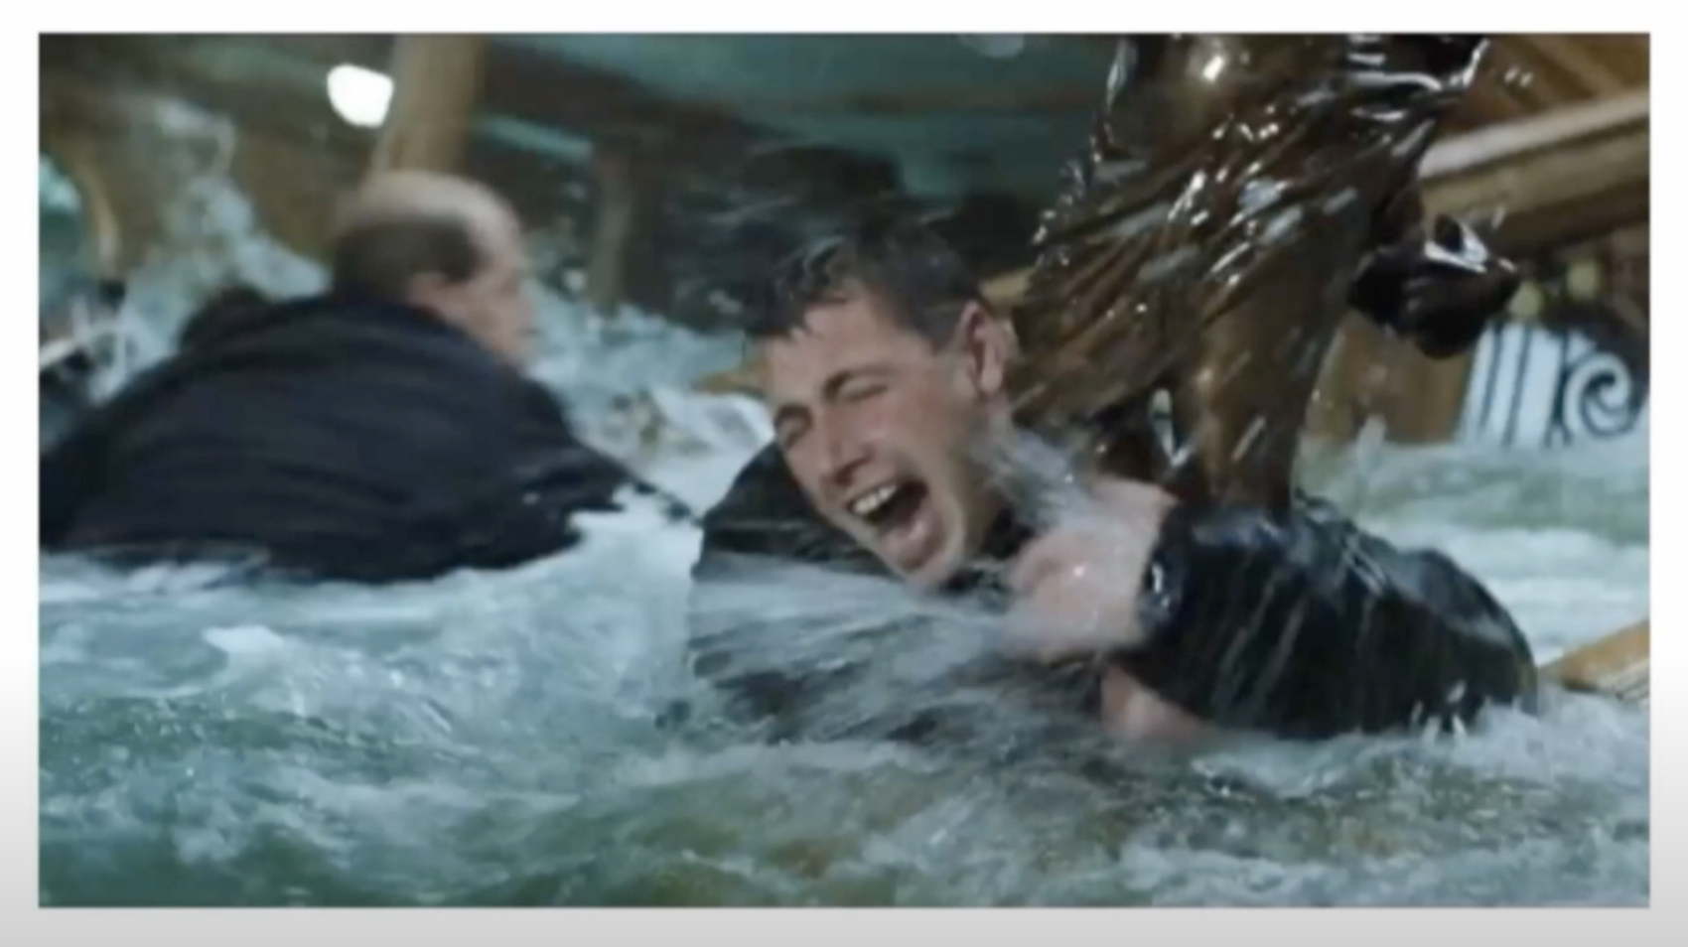
Paper 4: VisualCOMET - Reasoning about the Dynamic Context of a Still Image
From Choi’s talk at HAI 2020

Slide 43
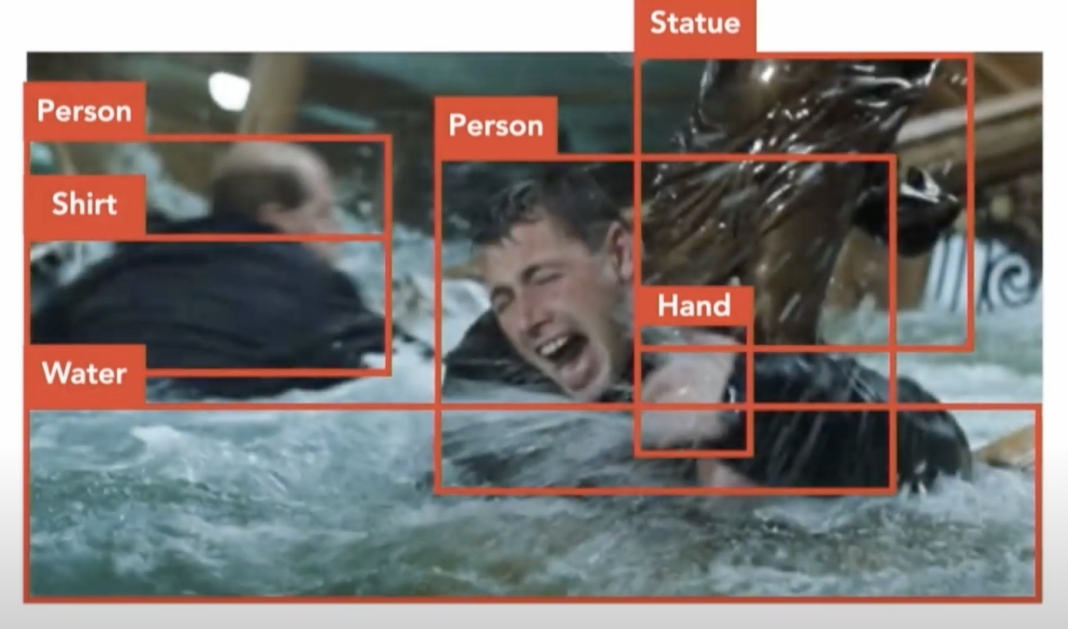
A person is holding onto a statue in the water
From Choi’s talk at HAI 2020

Slide 44
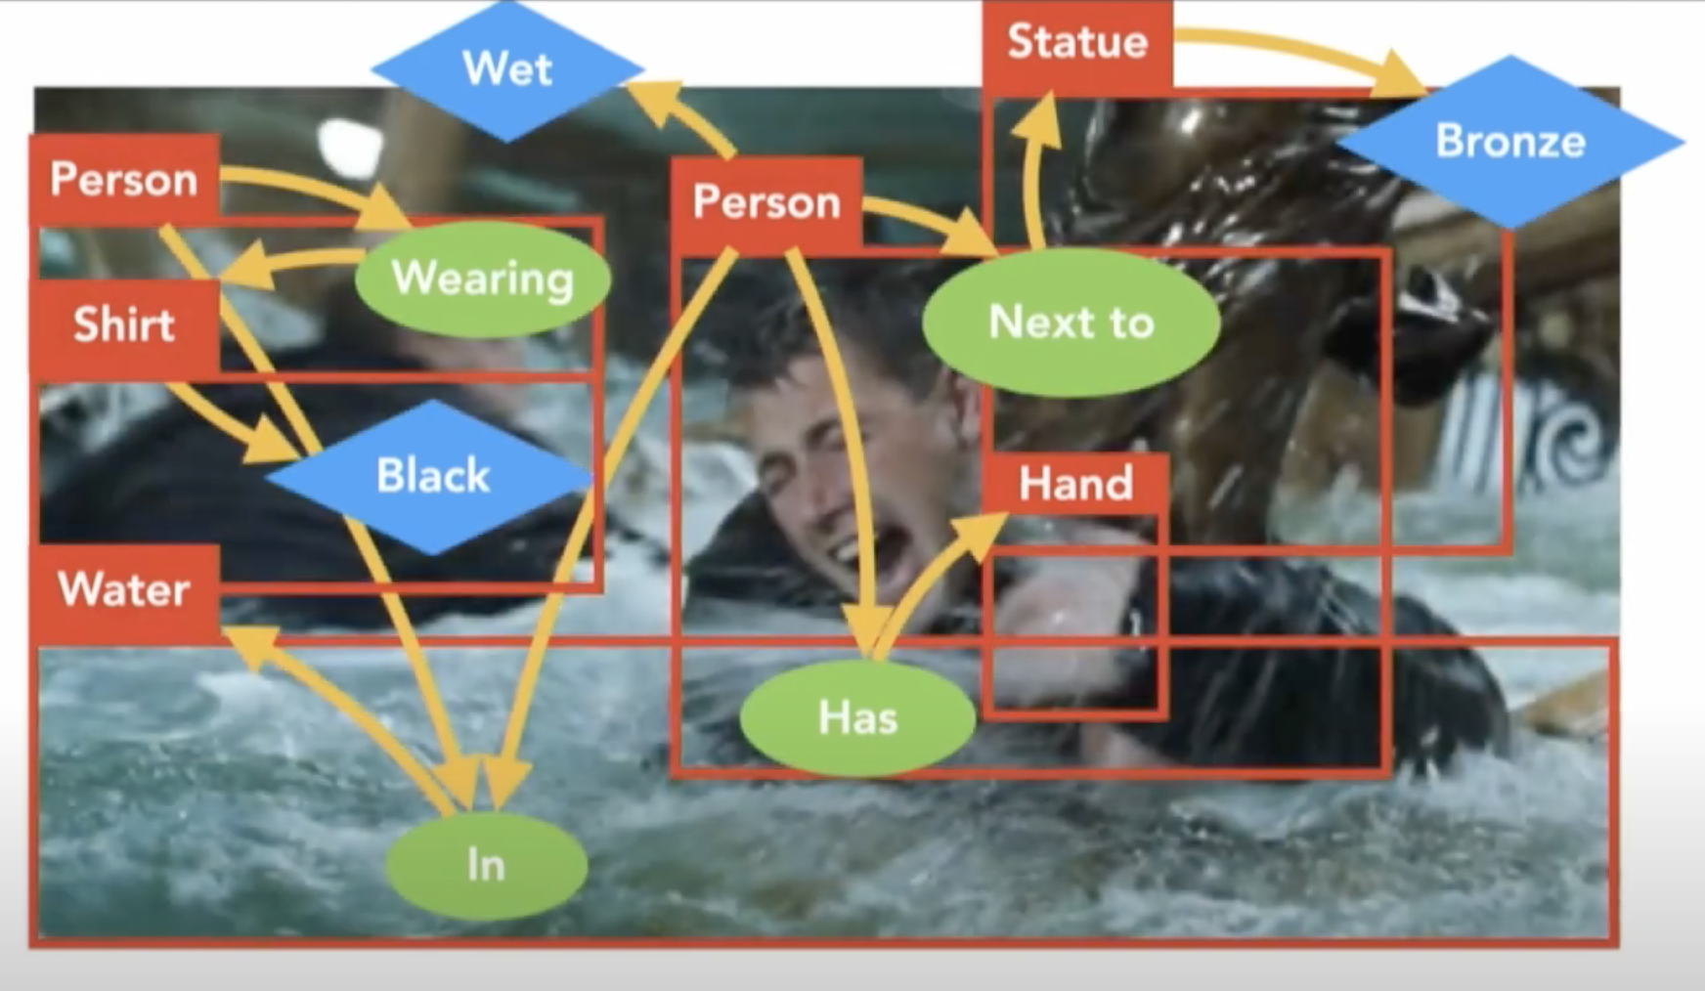
A person is holding onto a statue in the water
But why?
From Choi’s talk at HAI 2020

Slide 45
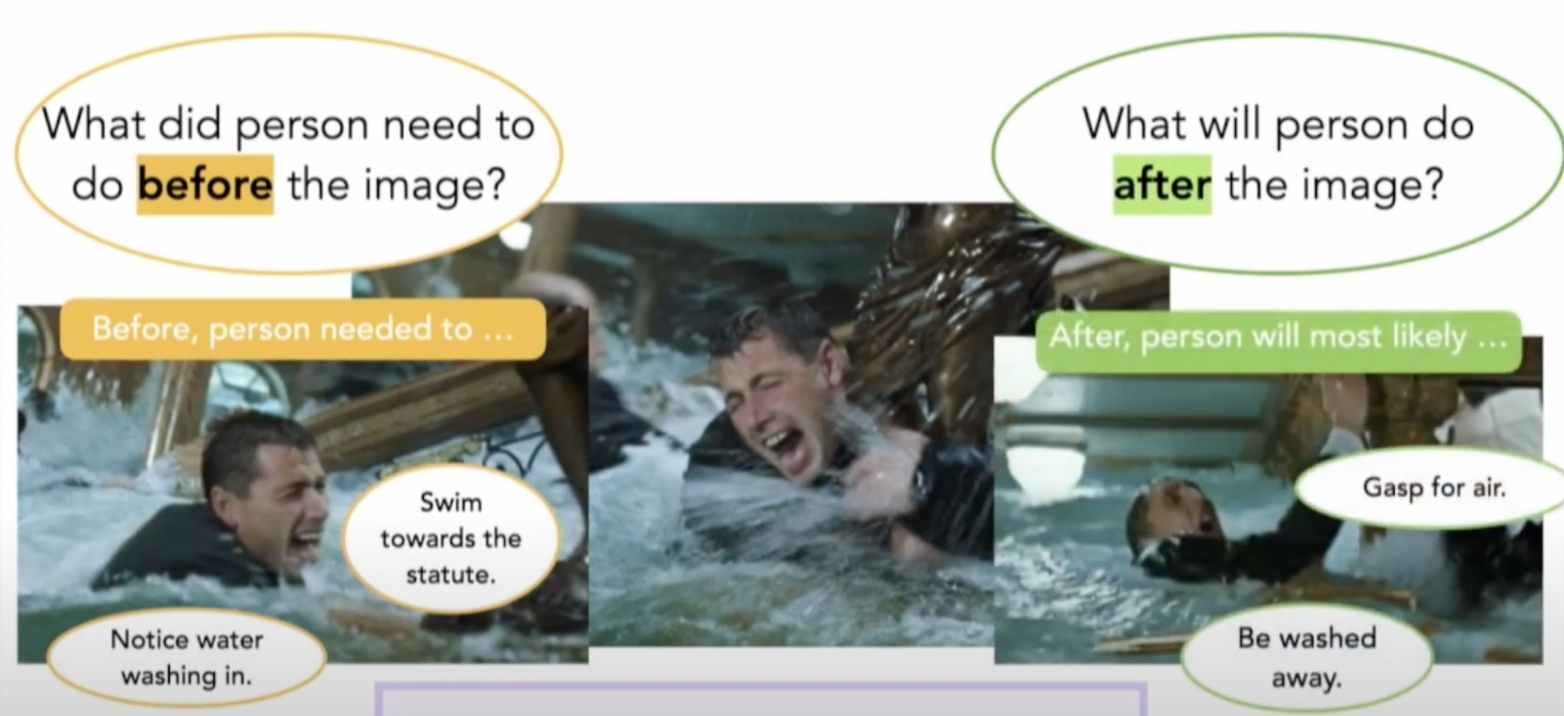
From Choi’s talk at HAI 2020

Slide 46
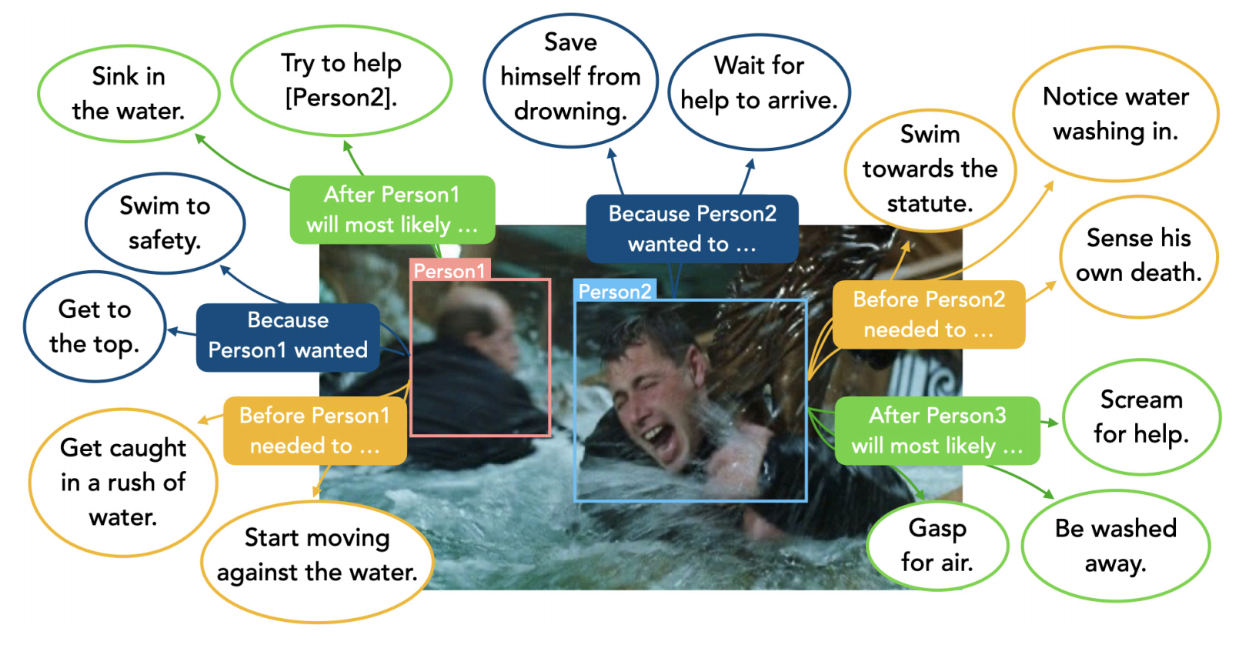

Slide 47
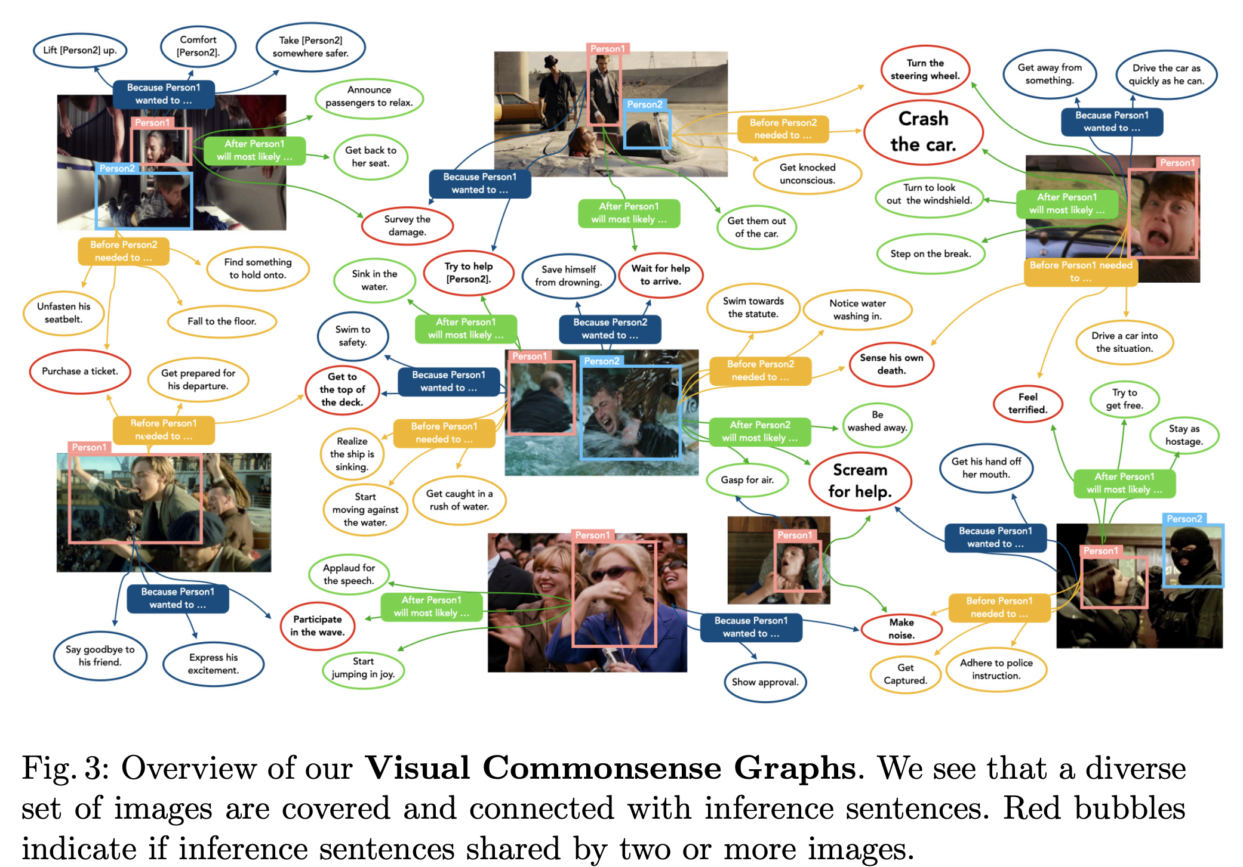

Slide 48
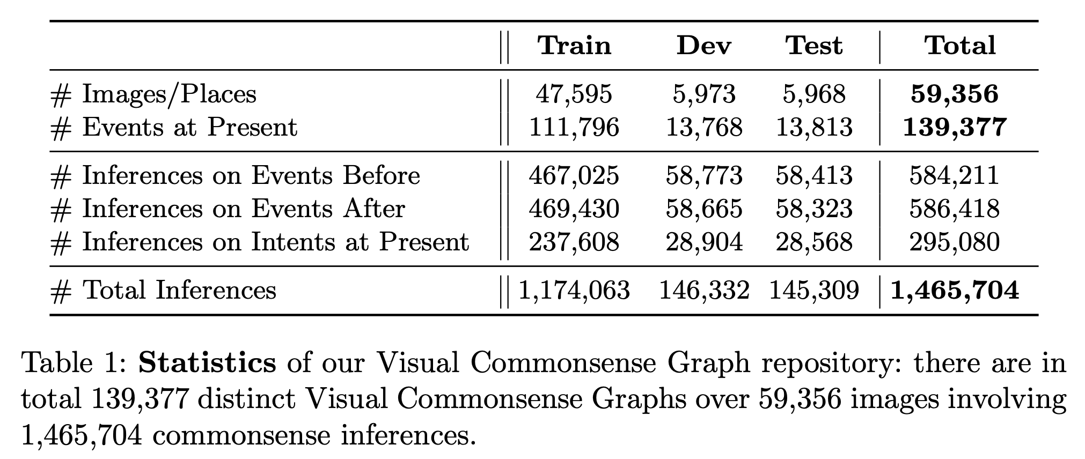
Dataset

Slide 49
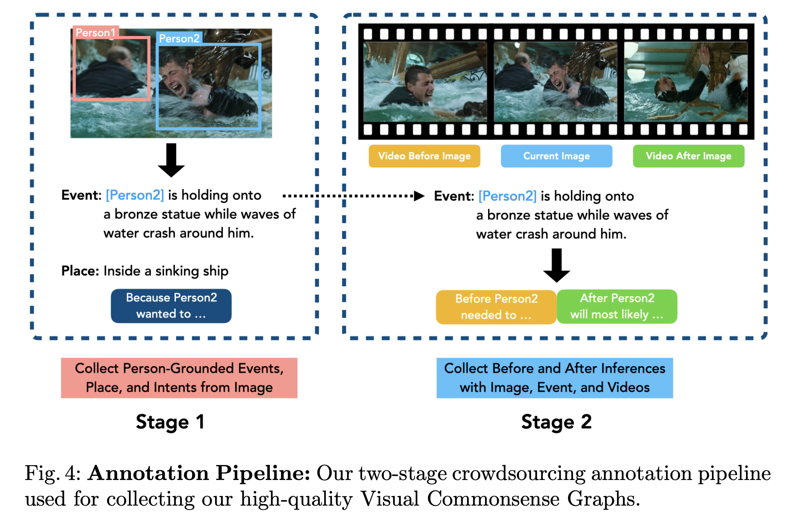
Dataset

Slide 50
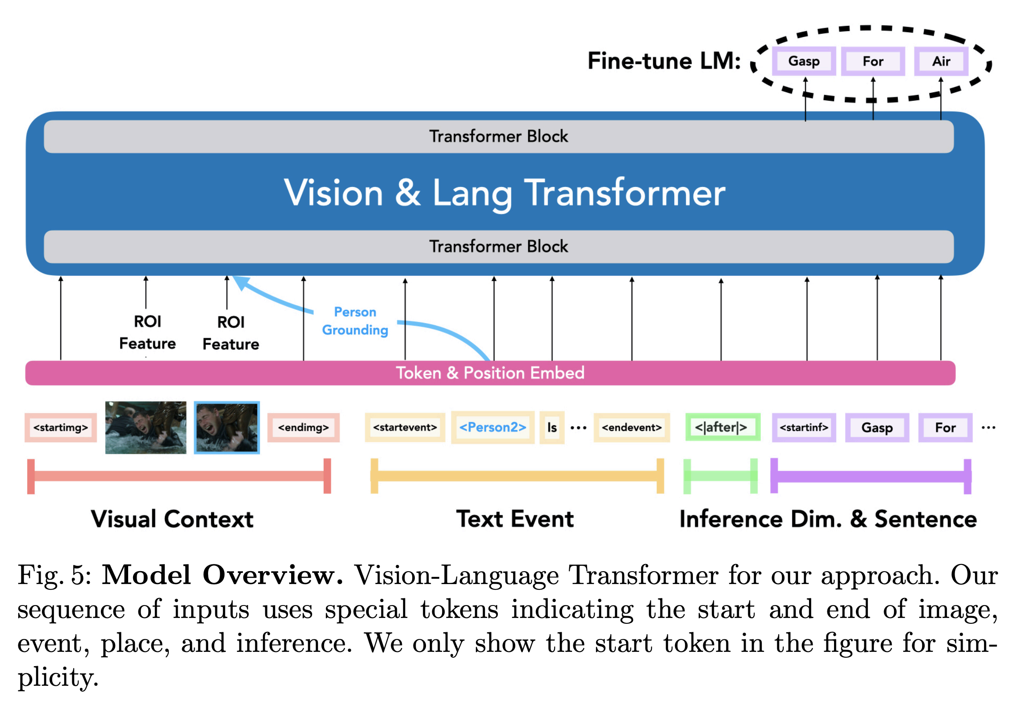
Model

Slide 51
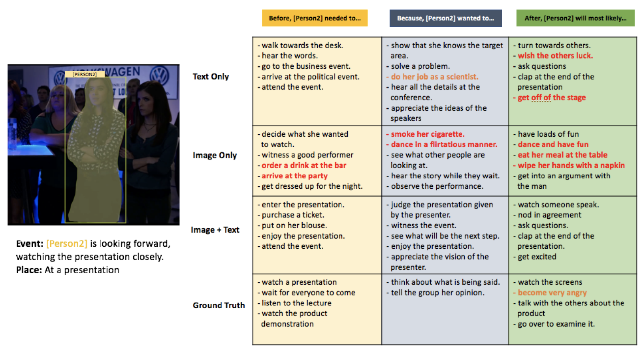

Slide 52
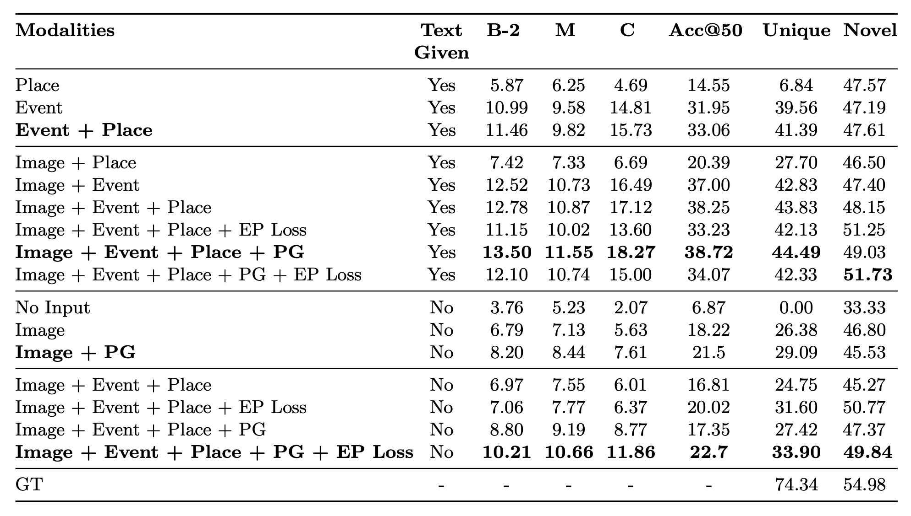

Slide 53
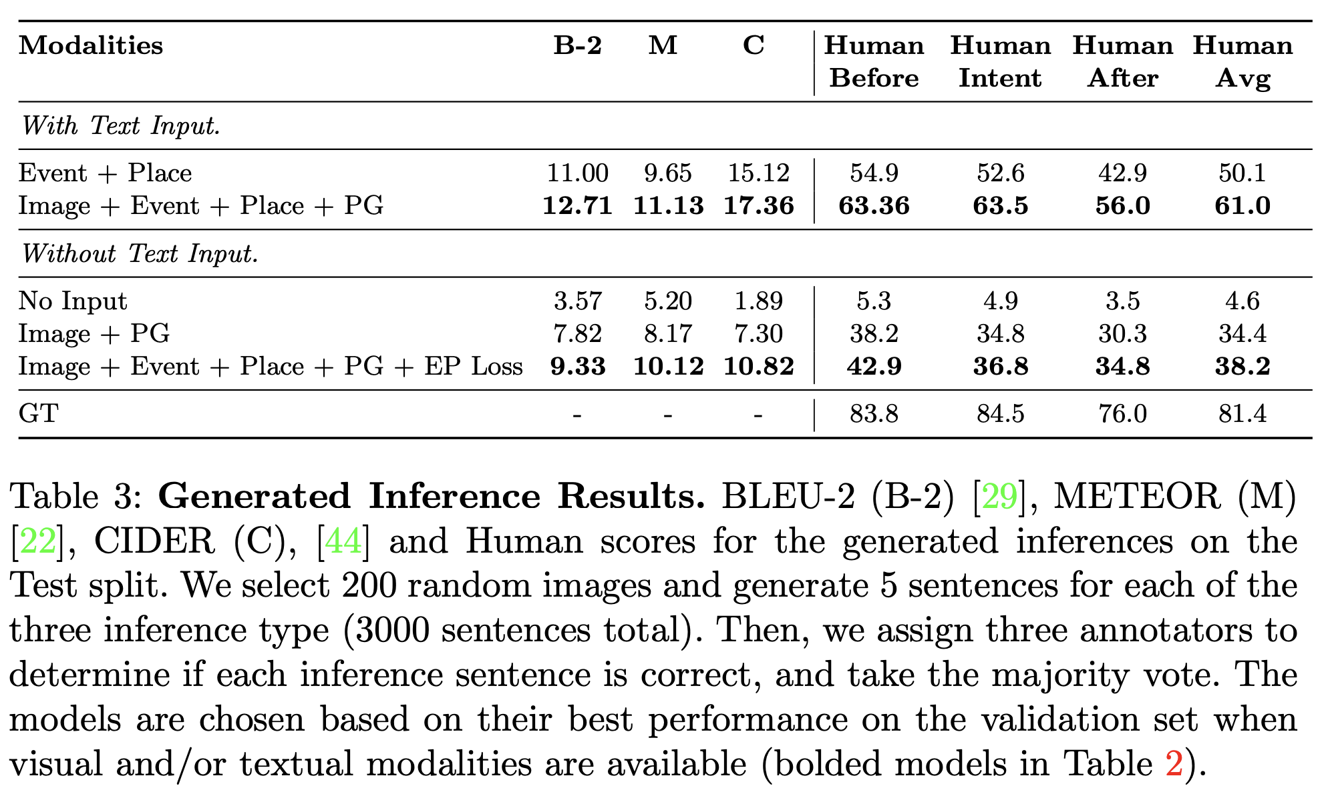

Slide 54
Conclusion
VisualCOMMET:
framework of visual commonsense reasoning tasks
predict events that might have happened before, events that that might happen after, and the intents of people at present
First large-scale dataset of Visual Commonsense Graphs
1.4 million textual descriptions of visual commonsense inferences carefully annotated over a diverse set of 59,000 images.
Integration between visual and textual commonsense reasoning is crucial to achieve the best performance.

Slide 55
Paper 5: Modeling Semantic Relational Set Abstractions in Videos
Humans are capable of
Detecting what different events have in common and organize them into abstract categories.
Essential ability for reasoning and intelligent decision making
Can machines learn how to perform semantic relational abstraction between a set of events?

Slide 56
Encoding conceptual relationships
Tasks:
Set abstraction (what is in common?)
Set completion (which new video goes well with the set?)
Odd one out detection (which video does not belong to the set?)
Relational event abstraction (rank samples by their semantic relationship).

Slide 57
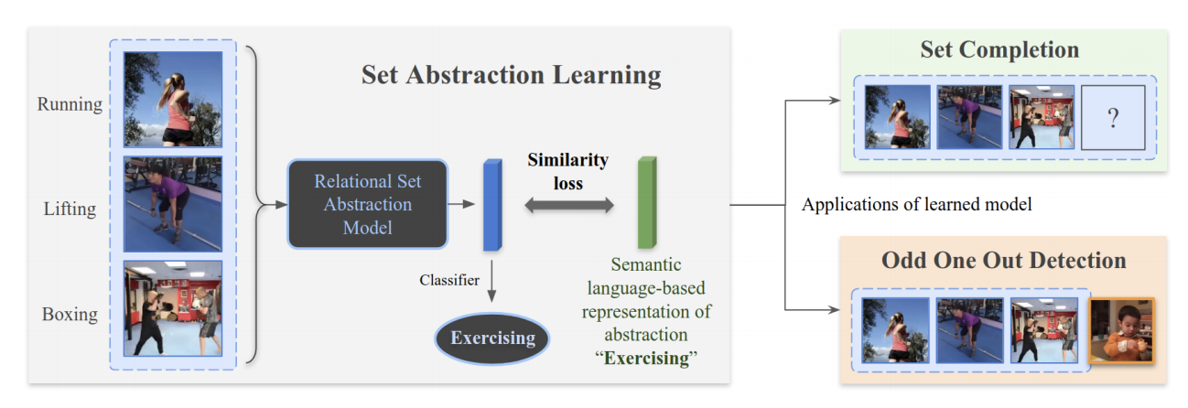
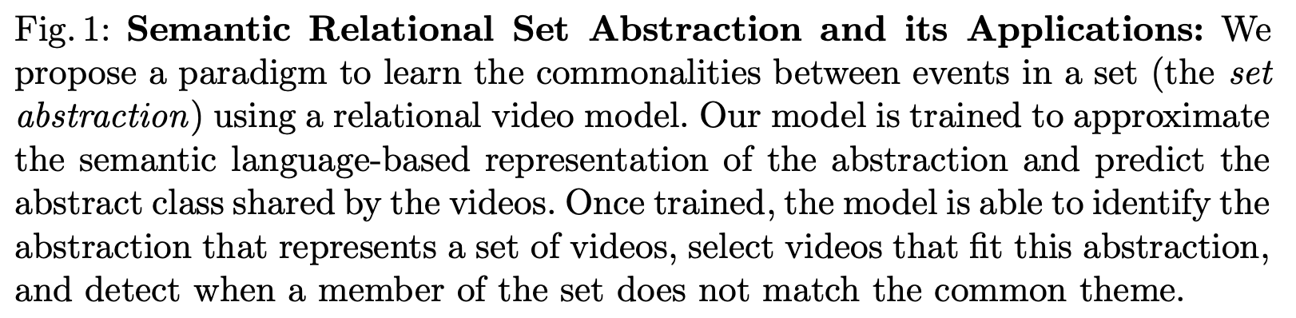
Set abstraction

Slide 58
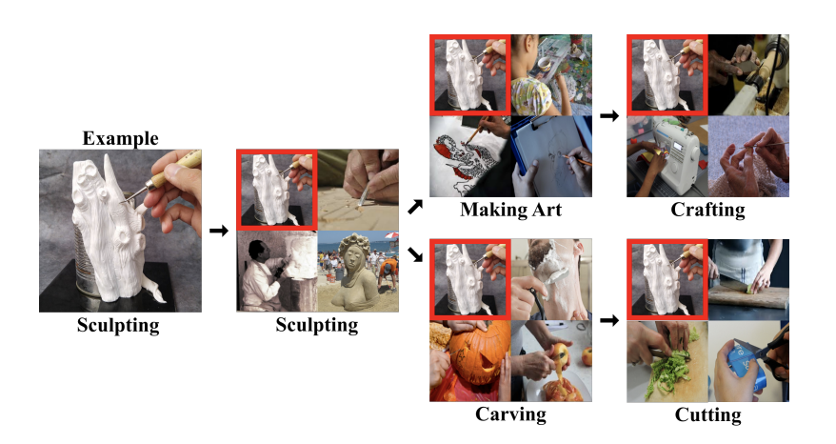
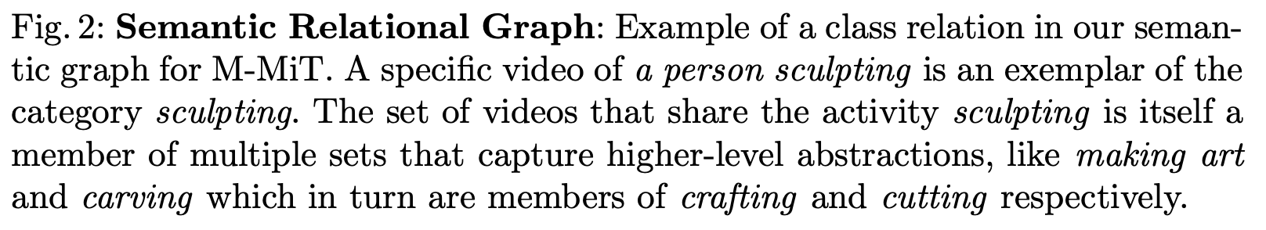

Slide 59
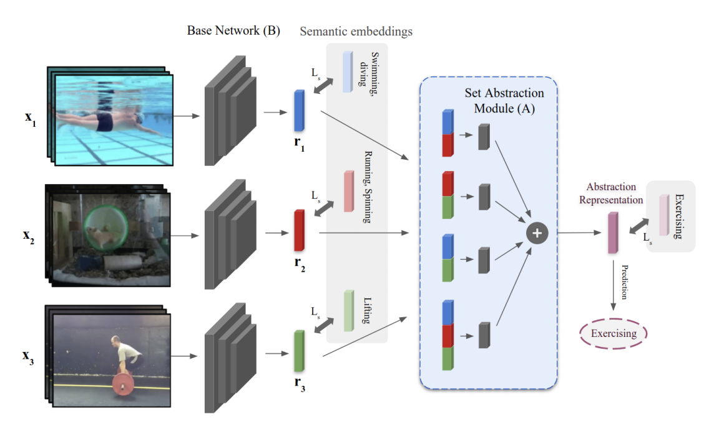
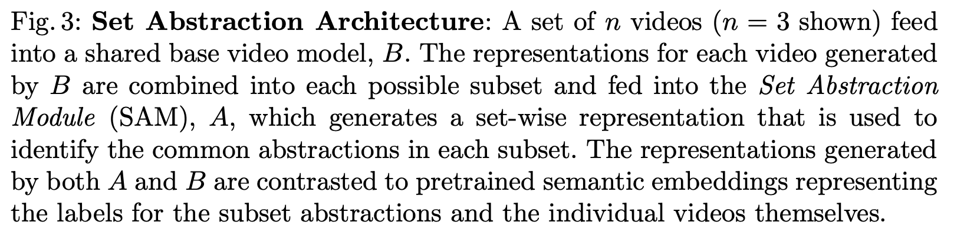

Slide 60
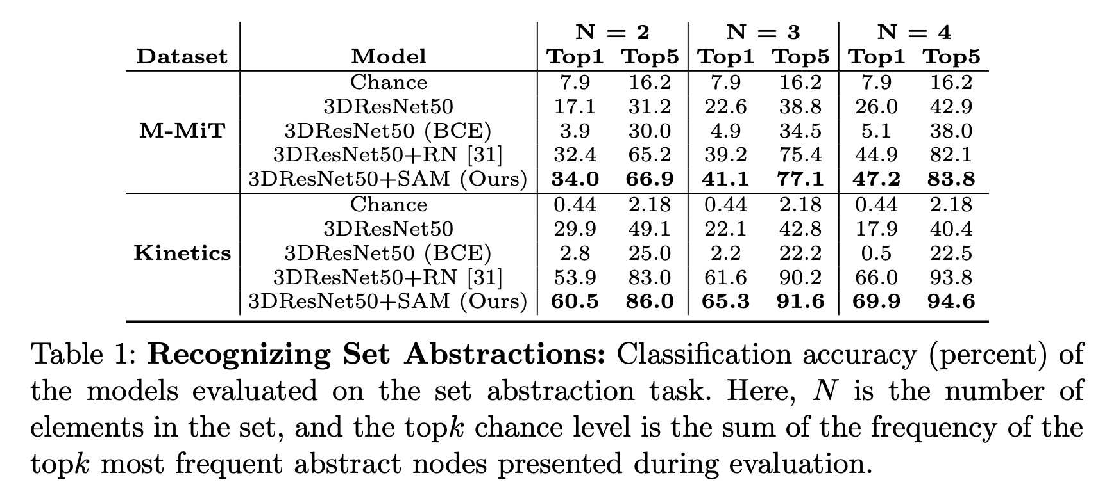

Slide 61
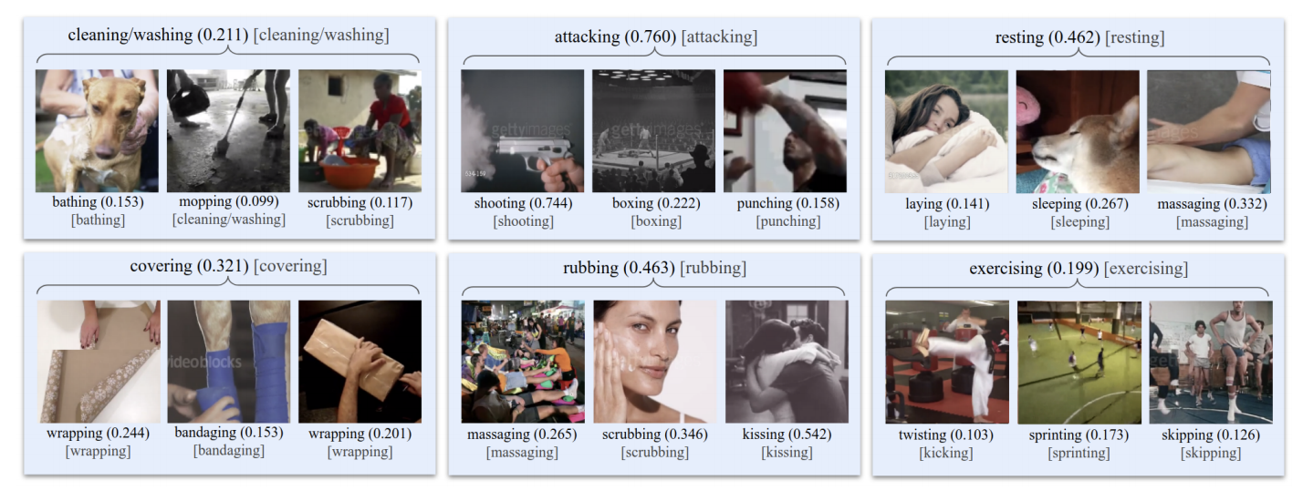


Slide 62


Slide 63



Slide 64


Slide 65



Slide 66
Conclusion
Machines can capture semantic relationships across diverse events and predict common patterns.
Rooting the model in language helps with learning abstractions that are better suited to represent how people form high level classes.

Slide 67
Paper 6: Crossmodal Language Grounding in an Embodied Neurocognitive Model
Human infants are able to acquire natural language seemingly easily at an early age
Learning language by interacting with environment and caregivers
Neuroscience: “Language is embodied and grounded by sensory and sensorimotor modalities” *.
Thus, machines should follow a neurocognitive model of learning in order to acquire an useful mental model.
* Pulvermüller, F. (2018). Neural reuse of action perception circuits for language, concepts and communication.

Slide 68
Biological Inspiration
The brain is a great in integration:
Complex interplay of neural populations globally and locally
Oscillations in multiple timescales
In higher stages, spatial and temporal hierarchy are organized in consistent cell assemblies
Crucial for the development of concepts
Assemblies are activated during language processing and overall thoughts

Slide 69

Computational model
Continuous Time Recurrent Neural Networks (CTRNN)
Multiple Timescale Recurrent Neural Network (MTRNN)
Input-Output (IO, 𝛕 = 2)
Context-fast (Cf, 𝛕 = 5)
Context-slow (Cs, 𝛕 = 70)
Context-controlling (Csc)
Context bias: decomposes dynamic sequence from static initial bias.
Context abstraction: Composes a static bias from dynamic sequence.

Slide 70


Slide 71
Computational model
MTRNNs with context abstraction:
Sensory inputs from multiple modalities
Composes sensation into an overall meaning for the sensation
MTRNN with context bias:
Verbalizing the observed sensation in natural language
Decomposes meaning into a verbal description
Context controlling units of MTRNNs:
Coupled in cell assemblies.
Sparse latent representation can emerge through iterative learning

Slide 72




Developmental Robot
NICO (Neuro-Inspired COmpanion) as model of an infant learner
Kerzel, et al. "NICO—Neuro-inspired companion: a developmental humanoid robot platform for multimodal interaction." In 2017 26th IEEE International Symposium on Robot and Human Interactive Communication (RO-MAN), pp. 113-120. IEEE, 2017.

Slide 73

Developmental Robot
NICO (Neuro-Inspired COmpanion) as model of an infant learner

Slide 74
Datasets
EMILv1 Data:
240 sensation-description pairs
up to 740 time steps for the perception streams
up to four words for the description
Descriptions’ vocabulary: 68 words and 4 punctuation symbols.
Each word represented with one to nine phonemes
EMILv1 + Teacher Data:
Nouns and verbs replaced by synonyms + gaussian noise to perception

Slide 75
Representation and Training
Phonetic:
Utterances into phonetic sequence. Simple one-hot vectors.
Mel-Frequency Cepstral Coefficients to 13D space (33 ms)
Word embedding:
GloVe-6B
Visual input:
VGG16 + PCA to 19D space. Pretrained in ImageNet.

Slide 76

Generalization
Generalization is difficult:
Phonetics: small errors such as pauses that are too long or producing incorrect phonemes at the end of words or utterances.
Word embedding: non related words are mixed up.
The timescale is important for performance

Slide 77

Timescales

Slide 78

Latent Representations in Cell Assemblies

Slide 79

Latent Representations in Cell Assemblies

Slide 80
Conclusions
Embodied neurocognitive models trained end-to-end allows the emergence and generalization of language grounding
Timescale is important for learning (also observed by cognitive science)

Slide 81
Discussion Q1
From the approaches we have discussed here, which one you think seems to be the most promising and why?

Slide 82
Discussion Q2
How important is cross-modality learning for NLP? Can we achieve better LM without it? Do we need more data or better models?

Slide 83
Discussion Q3
Should human intelligence or human-like learning be the goal regarding AI development?

Slide 84
World knowledge
Imagine the scene:
Manny approached the table with the steaming plate. “Watch out!” said Emma. “There, I moved the water for you.”
Why did Emma warn Manny?
What would be the fate of the table had Emma done nothing?
Can we expect a LM to unravel all the layers of this situation into a faithful model through reading how humans write?

Slide 85


